Slide 1




1st Information Session
Reach High II 3rd Call
Applications: 30th July -28th August 2026

Slide 2

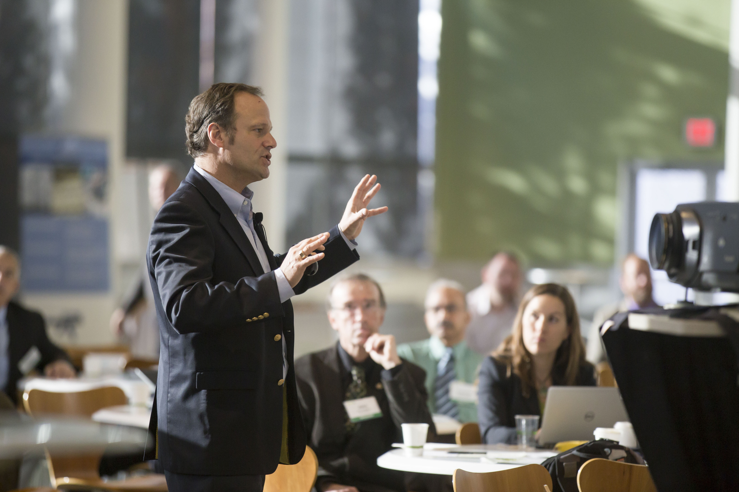
REACH HIGH II
Post-Doctoral Programmes can help to contribute towards Malta's economic, social,
environmental, and cultural development, and therefore contribute towards research in identified areas of national and EU priorities
Aim: The investment in human capital with a focus on emerging labour markets including areas of green, digital, STEM, smart specialization, innovation and other sectors addressing the evolving development needs and challenges characterizing Maltese society, in line with Malta’s national priorities.
The aim is to producing well-rounded, professional researchers who contribute to the advancement of
their fields of knowledge internationally, using a variety of relevant skills, and promote research development and competence.
The Reach High II Scholars Programme is co-funded by the ESF+ 2021 – 2027

Slide 3
PRIORITY AREAS
STEM
Smart Specialization
Green, Digital and Innovation
Any other areas that focus on evolving development needs and challenges characterizing Maltese society, in line with national and EU priorities.

Slide 4

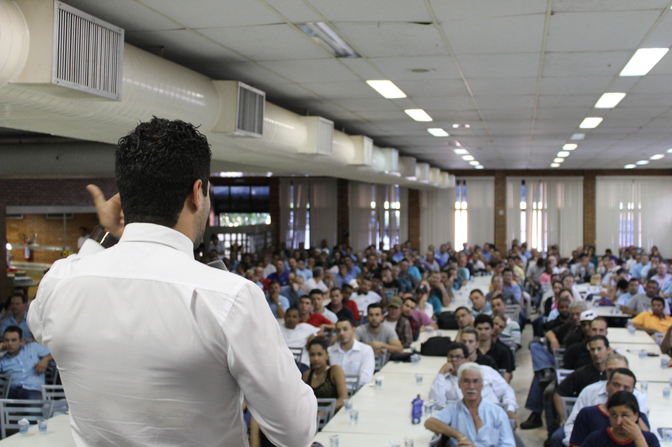

RESEARCH PROJECT
Applicants need to propose a research project that falls under the priority areas and under the mentorship and support of a local/foreign University recognised by the Malta Further and Higher Education Authority (MFHEA).
Applicants must demonstrate the acceptance of the accredited research institution for the duration of the research project or signed agreement between host institutions.
This is a competitive scheme, not all applicants will receive the research grant .

Slide 5
ELIGIBILITY
Be a Maltese Citizen, EU Citizen, or Third Country National ( with long term residence status) and been residing in Malta for the past 5 years ( review Clause 4.1)
The Term may be renewed up to a maximum total term of 35 months, but in any case, up to no later than 30th June 2029
The Post Doctoral Research must start between 31st July 2026 and 31st December 2026
QUALIFICATIONS
Applicants must be in possession of a PhD, or have an attestation letter that they will be awarded their PhD before the commencement of the Project
END DATE OF RESEARCH PROJECT
START DATE OF RESEARH PROJECT

Slide 6

IMPORTANT APPLICATION INFORMATION
  Applicants who have already undertaken/or are currently undergoing a Post-Doctoral research/project are not eligible to apply under this scheme.
  Applicants in possession of other national/EU (or a combination of both) public grants or national/EU/ Commonwealth (or a combination) scholarships for the same research project shall be deemed ineligible under the Reach High II Post-doctoral scheme if not notified and approved by the Board/Office
  Awardees shall need to notify beforehand the Reach High II Board/Project Leader of any commitment of employment during the duration of their studies. Any additional paid work needs to be approved by the Reach High II Board/Project Leader and must be on Part –time basis not exceeding 20 hours per week.
  In line with the ESF+ Programme obligations, awardees are expected to remain/return to Malta for a minimum period of 3 years post completion of the Research Project

Slide 7

DEADLINES
The complete Application Form and mandatory documents shall be submitted by Friday 28th August 2026 at noon (Local Time).
Other documents issued by the Host Institution and MQRIC shall be submitted by 30th October 2026 by 4PM (Local Time). (Refer to clause 9.2)

Slide 8

Friday 28th August 2026 (NOON)
  Residence permit or permanent residence certificate or long-term resident status (mandatory where applicable).
  Applicant's curriculum vitae; (Mandatory)
  Declaration (Mandatory)
  Certificates of PhD degree, or attestation issued by the competent department (Mandatory).
  Justification for the Research Proposal including links with national and EU priorities and the relevance and impact on Malta; (approx 1,000 words) (Mandatory)
  A Technical Statement of Proposed Work and Research Plan (approx 1,000 words ) (Mandatory)
  Programme of Work (Gantt chart for work programme); (Mandatory)
  Two Reference Letters including contact detail of referees. (Mandatory)
  Supporting documents such as a list of previous publications/papers/papers accepted for publication and URL if applicable, (Mandatory where applicable)
  A copy of the Table of Contents and abstract / summary from their Doctoral Thesis (Mandatory)

Slide 9

30th October 2026 (4PM)
  ULA, A supporting document attesting the acceptance of the applicant by the host institution sent directly to the Reach High ll email confirming where the research work will be carried out, and assuring the required conditions for the suitable development of the research;
  If the research project is laboratory based, applicants will be asked to provide a letter of support from the host institution sent directly to the Reach High ll email confirming that laboratory space and access can be provided;
  Copy of MQRIC evaluation report/receipt (where applicable)

Slide 10


INTERVIEW PROCESS
  Applicants shall be invited to provide a short presentation explaining their research proposal as well as answering any queries the board may have with regards to their submission
  The mode and medium by which the interviews will be conducted will be decided by the Board
  Applicants will be notified of their ranking by the Reach High II Board/Office. Obtaining a pass mark does not automatically mean that a grant is being awarded.
  An Applicant is considered to have passed if 70% of the total allocated marks *clause 11 (500 marks) is obtained; nevertheless, this does not automatically mean that a grant is being awarded.

Slide 11
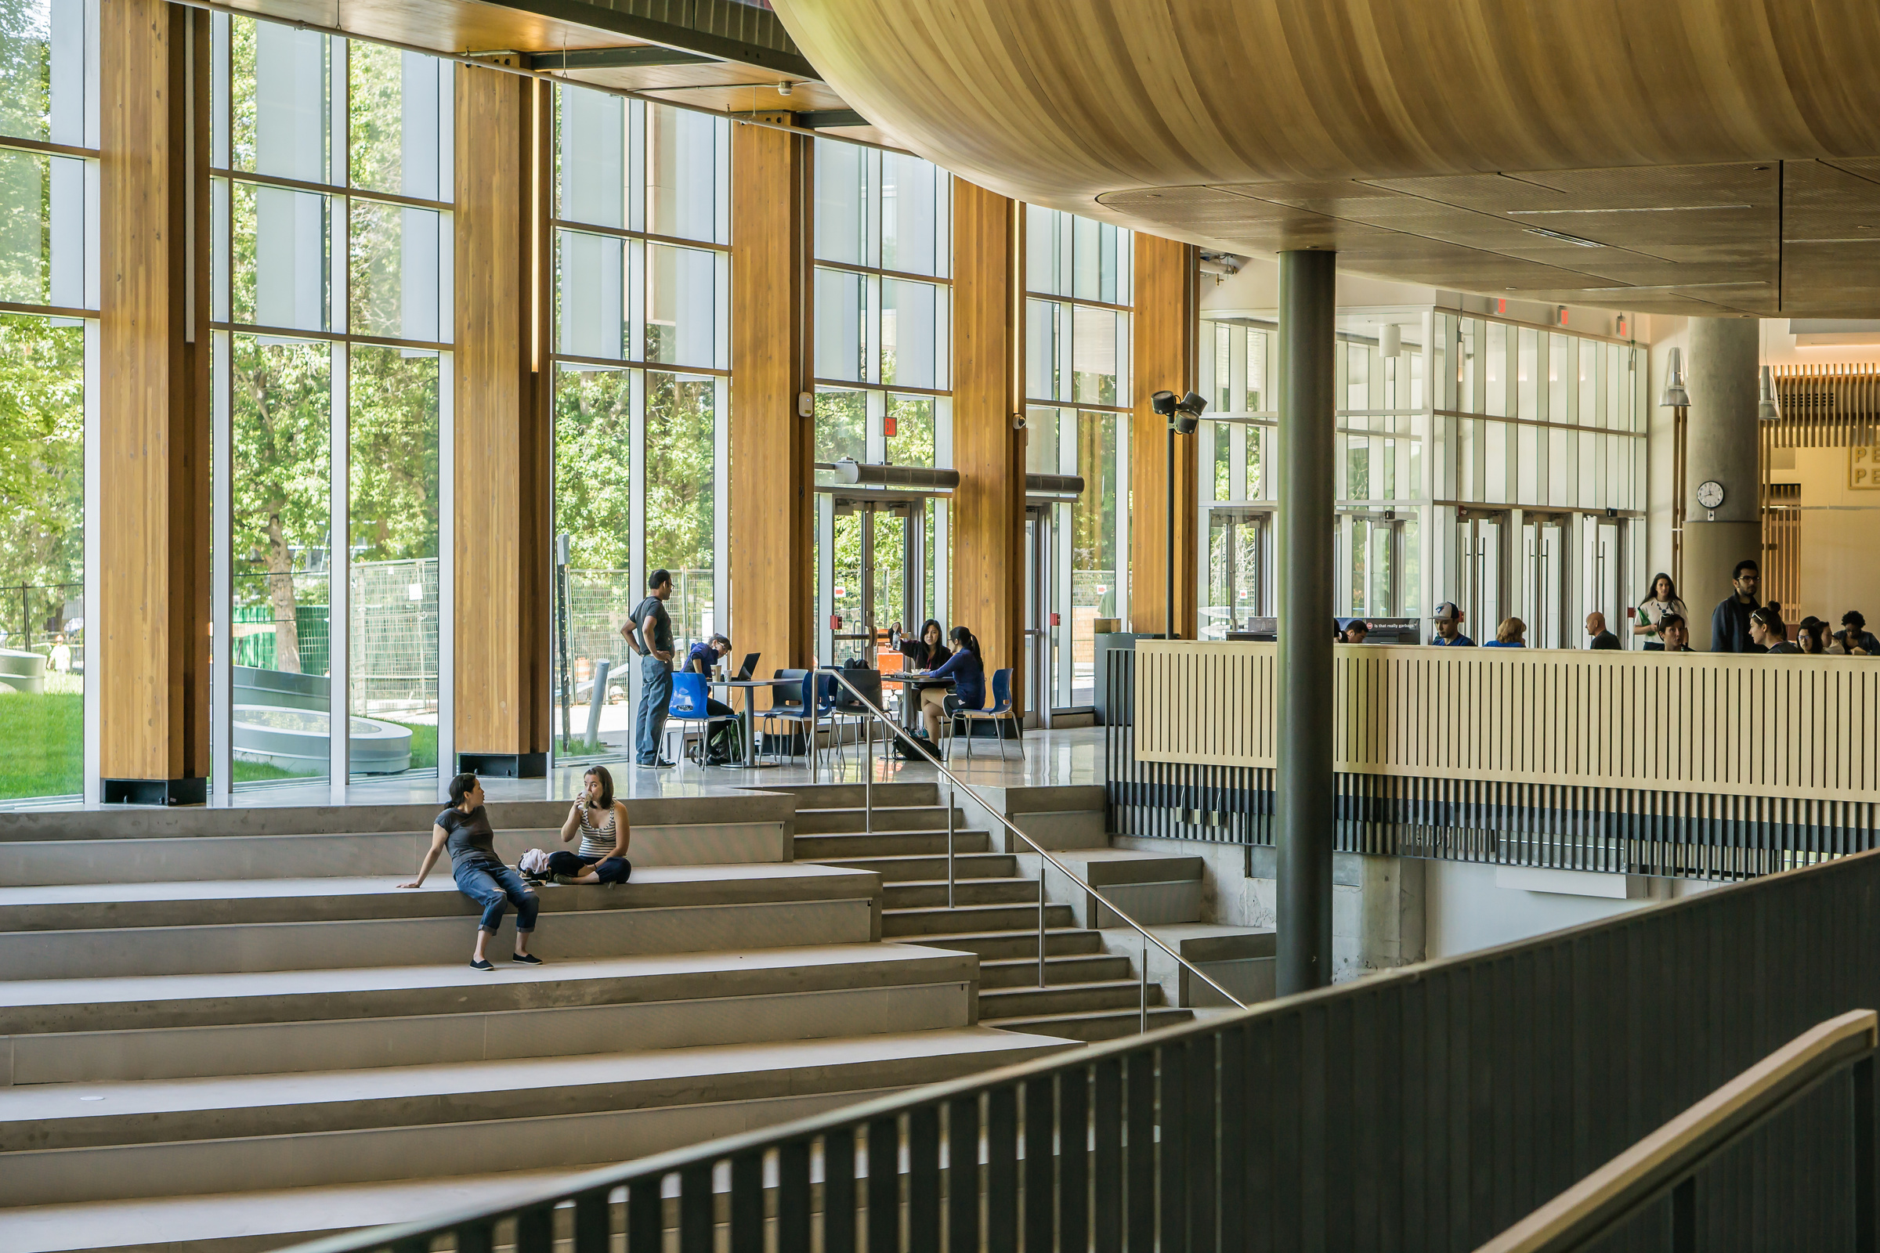
VALUE OF AWARD
The Total Grant awarded cannot exceed €200,000.
Post Doctoral Research Allowance
  Researchers will benefit from €43,696 per annum pro rata.
Direct Research Support Expenses
  Registration, enrolment fees or tuition fees, training-based fees, etc... which shall not exceed €3,000 per annum
  For Lab Based Research, costs cannot exceed €20,000 per annum (Bench Fees as defined in clause 3.5. List must include the cost of each item and inc with the attestation letter)

Slide 12
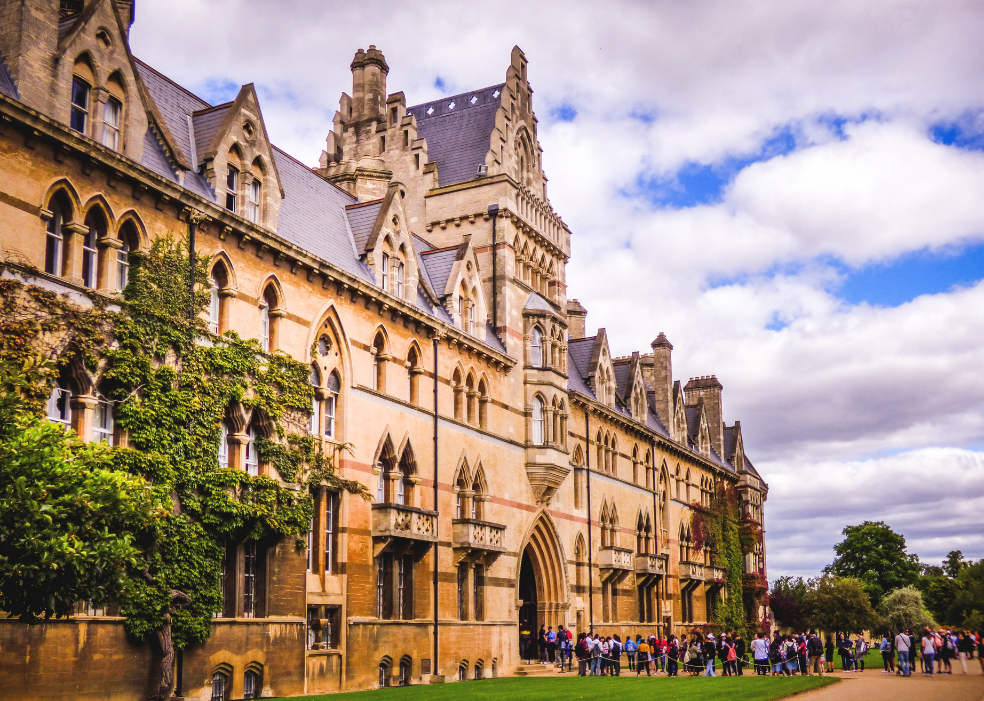
Research abroad allowance including accommodation
  In the case of research projects carried out outside Malta, the researcher shall also receive up to €10,000 per annum. This will be based on a case-by-case basis
Short Visits (accommodation not inc)
  Awardees required to go abroad for research purposes or on their programme of study, will be entitled to (€200) per visit ( to a maximum of €2,400) over a 12 month period.
  For those whose visit is 30 days or longer the allowance will be calculated pro-rata on €4,000 per annum (accommodation not inc) subject to the provision of boarding passes and confirmation from their respective Institution confirming the purpose of their visit

Slide 13
OTHER IMPORTANT INFORMATION
01
Save for exceptional situations duly substantiated by the stakeholders, any change to the Mentor or Host Institution of the research project is not allowed.
The researchers need to write a minimum of three (3) publications in research journals throughout the duration of the research project.
02
The Researcher may not change the objectives indicated in the proposed work programme without consent from the Mentor and/or the Host institution.
03

Slide 14
INFORMATION FOR FUTURE AWARDEES
Grant Agreement
Progress Reports
Monitoring
Publicity
Awardees will be invited to sign an agreement and fill in a number of forms ( Review clause 13)
  Approximately every six (6) months researchers shall ask their academic mentor to submit to the Project leader a report confirming progress, which may include feedback on agreed schedules, milestones, and deliverables and research outputs of the researcher.
The research project might be subject to monitoring and control actions by national and European bodies according to the applicable legislation
All publicity (clause 17) associated with or arising from the
research undertaken by the researcher while in receipt of REACH HIGH II Scholars Programme -
Post-Doctoral Grants funding must contain acknowledgement of funding received from the
  grant and ESF+ 2021 – 2027

Slide 15

DELIVERABLES
  Final progress report from Mentor with URL address of publications and scientific creations resulting from the activity.
  Three publications in Research Journals
  Relevant publications in international renowned journals, publications in conference proceedings, papers in international conferences, etc...;
  The dissemination of results to public and private bodies and entities
  Technical reports etc...;
  Patents, ISO, new experimental devices, product standards derived from research results plans and proposals for the improvement of offered services innovative suggestions - proposals on resolving problems of production operators, instruments or protocols for monitoring or measuring variables in natural or man-made systems, pilot plants, etc (where applicable).
  A write up on the research work carried out

Slide 16
CONTACT INFORMATION
Website
https://myscholarship.gov.mt/en/
Email
reach-high.mes@gov.mt
Phone Number
2598 2671/77

Slide 17
THANK YOU
Any Questions?

