Slide 1
Online Application Form
Malta Arts Scholarships Scheme 2026

Slide 2
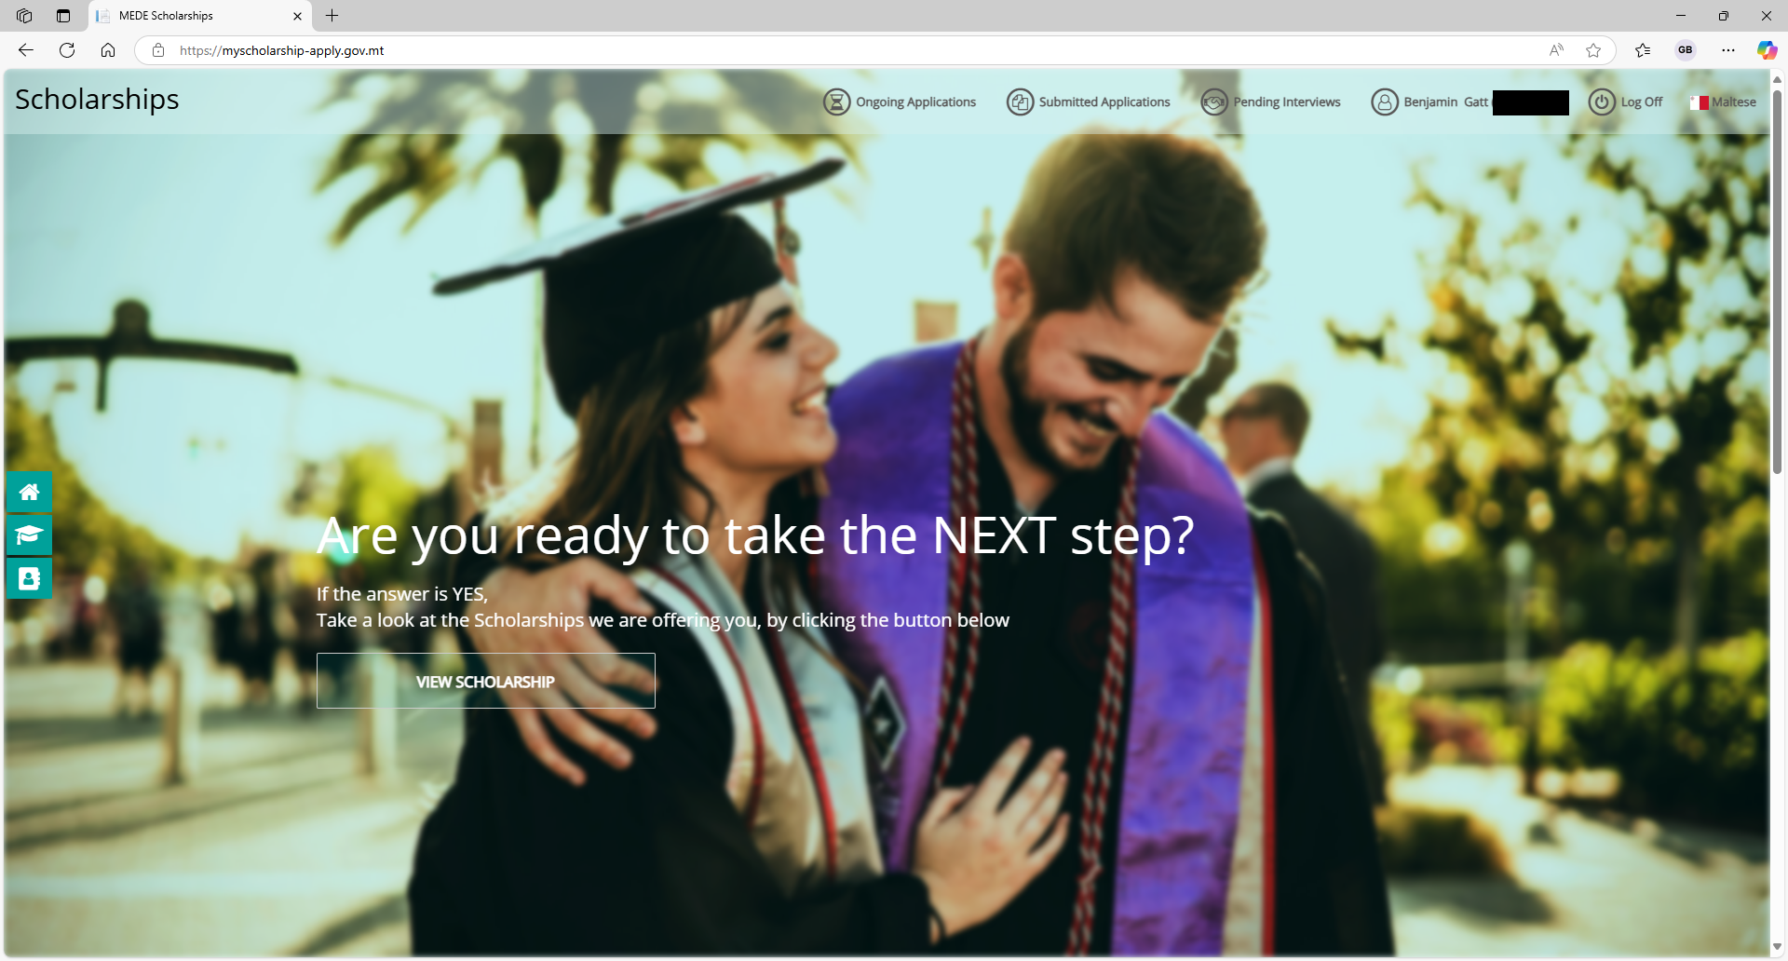

Slide 3
To apply online, visit
https://myscholarship-apply.gov.mt
then click
View Scholarship

Slide 4
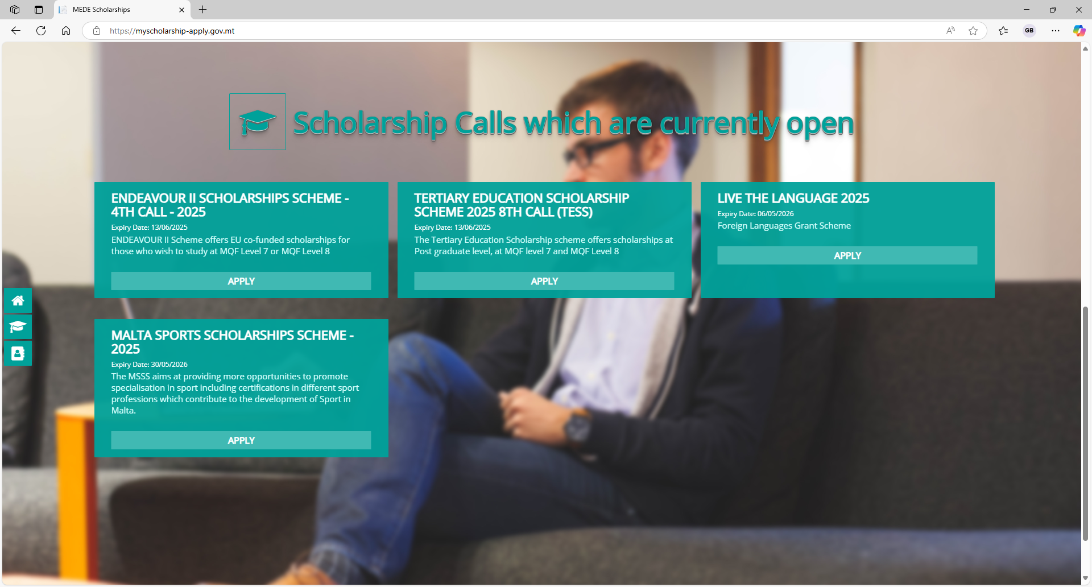

Slide 5
Click Apply under the
Malta Arts Scholarship Scheme 2026.

Slide 6
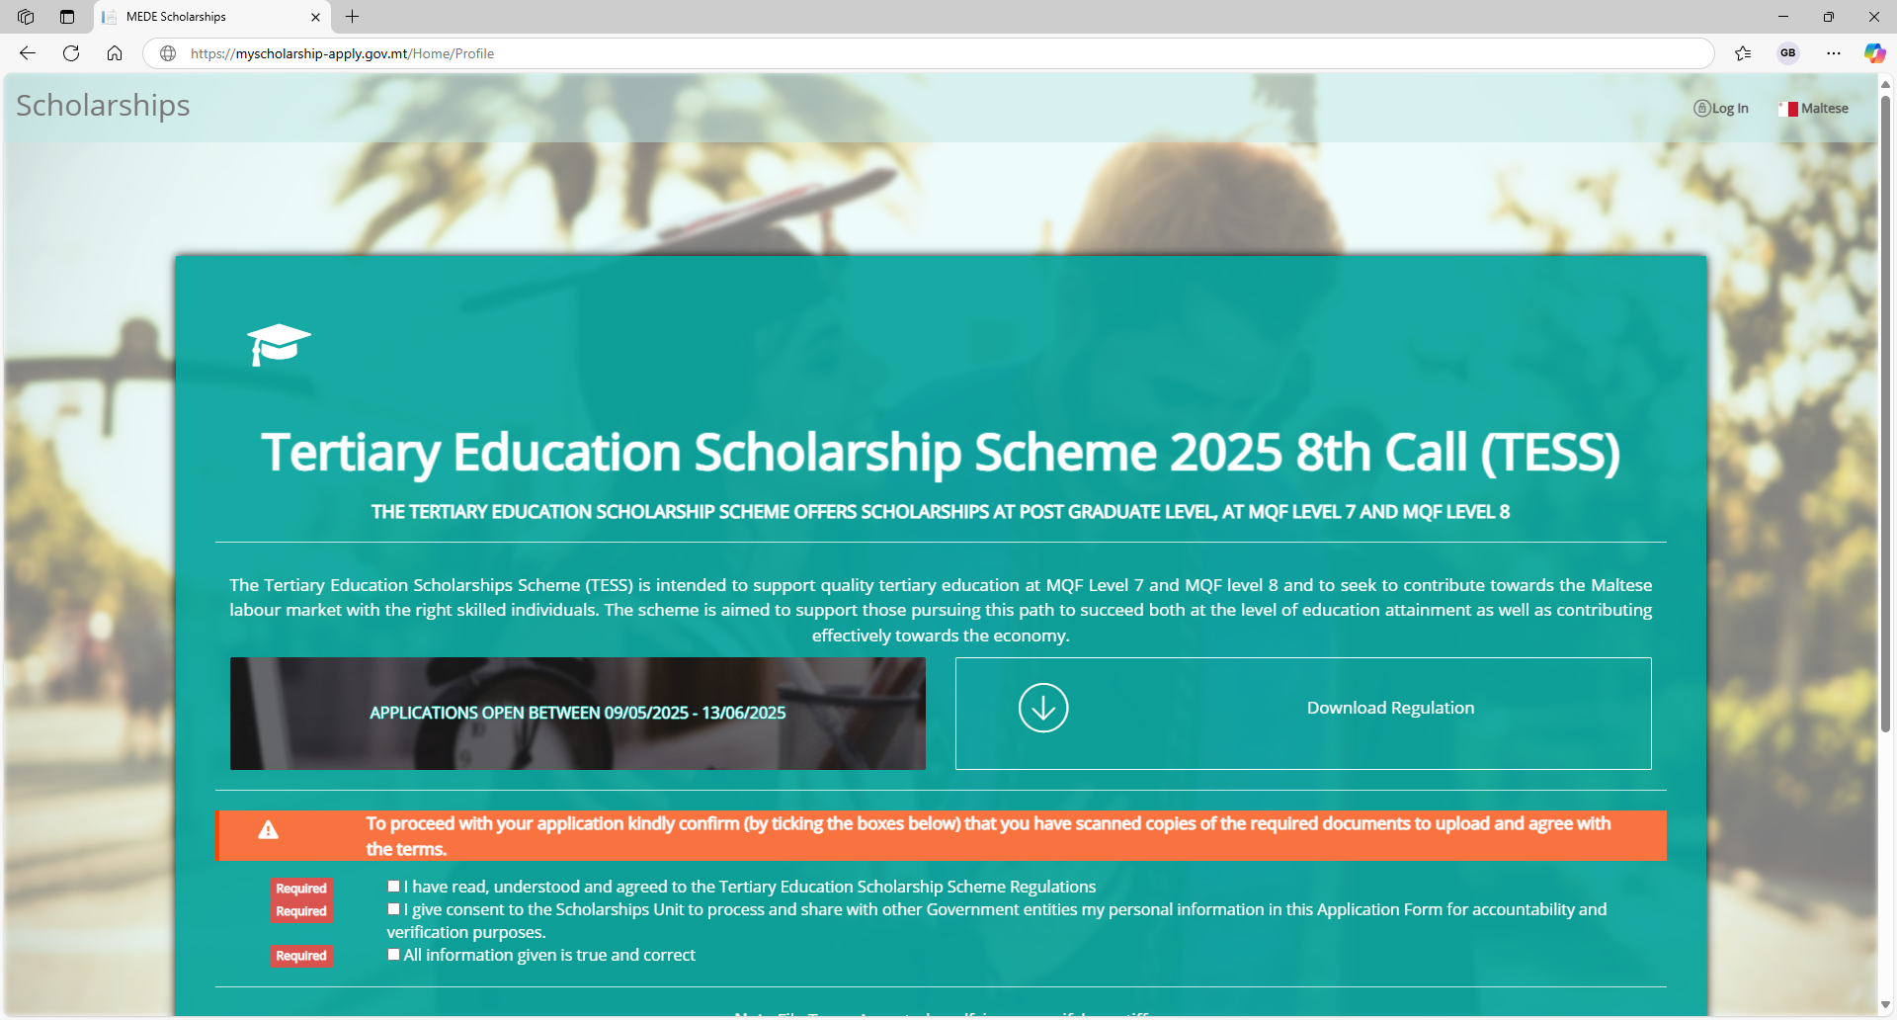

Slide 7
Click Log In at the
top right of the window

Slide 8
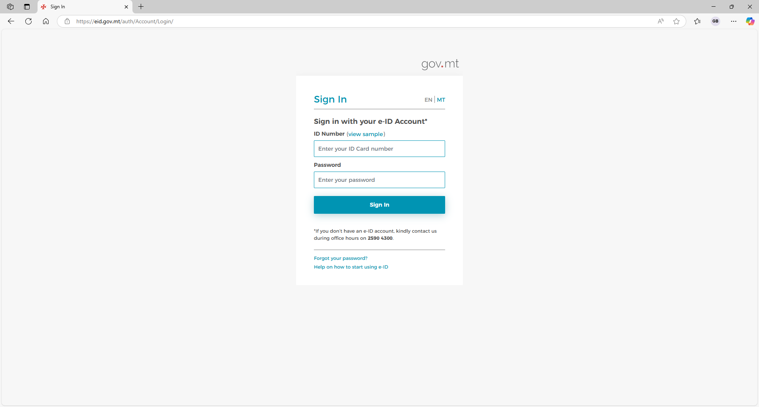

Slide 9
Sign in using
your e-ID

Slide 10
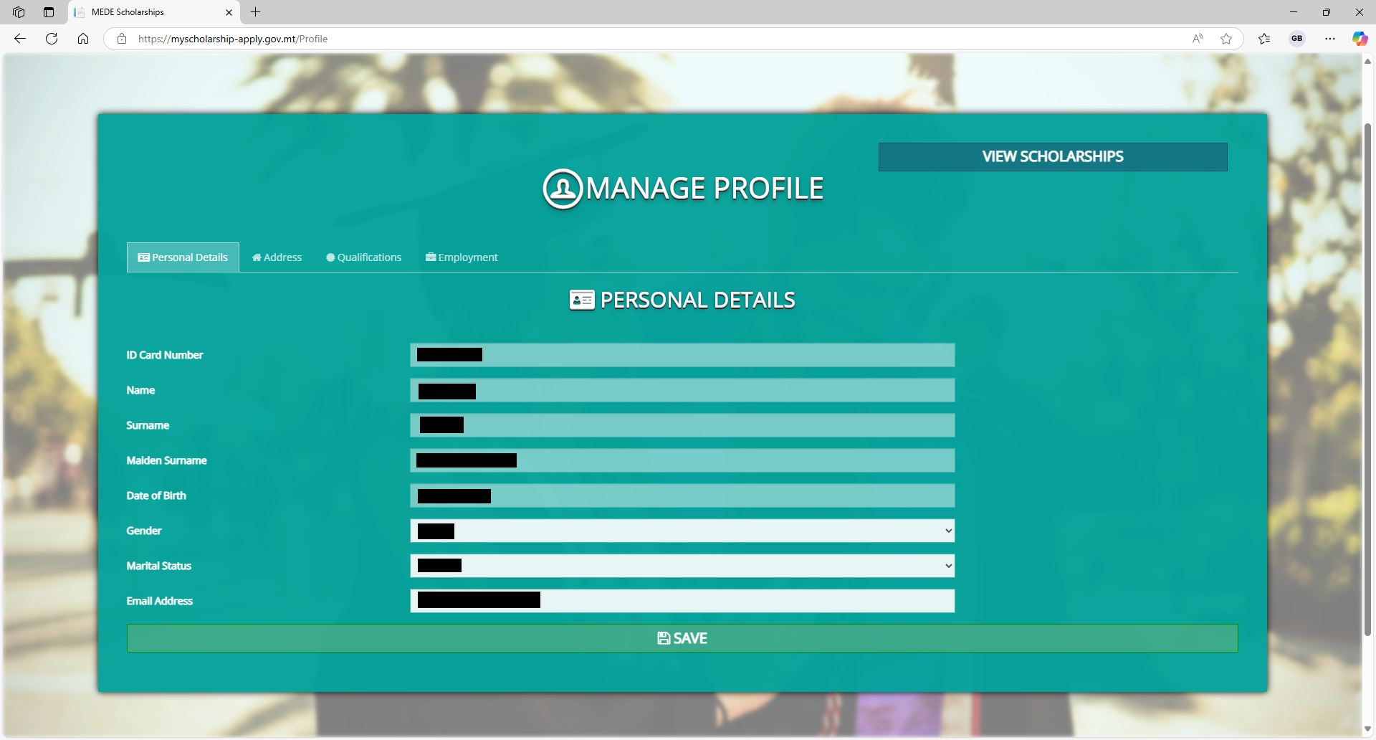

Slide 11
Ensure all the details
in your profile are
correct.

Slide 12
Do not forget to
check each tab.

Slide 13
Once you are done,
click Save.

Slide 14
Then click
View Scholarships.

Slide 16
You will be redirected
to this page.
Once again, click Apply
on the Malta Arts
Scholarship Scheme 2026.

Slide 17
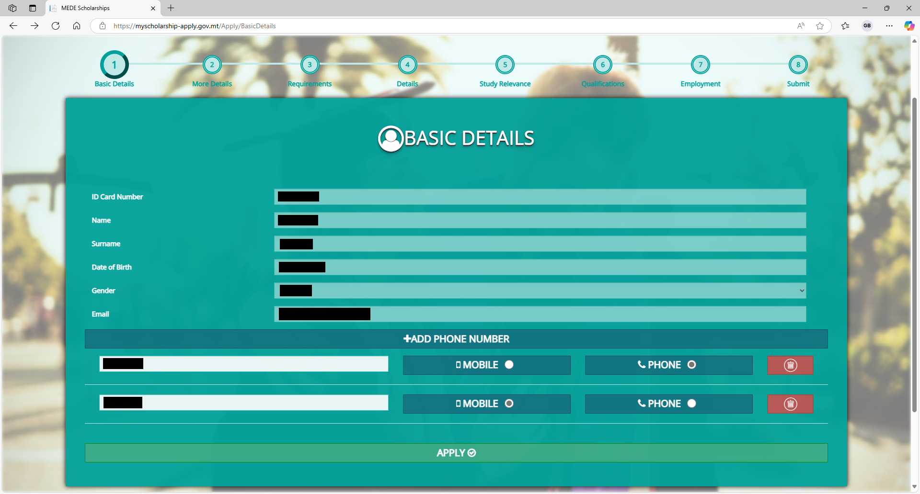

Slide 18
These details should now
be filled in automatically
Ensure all information
is correct, and then
click Apply.

Slide 19
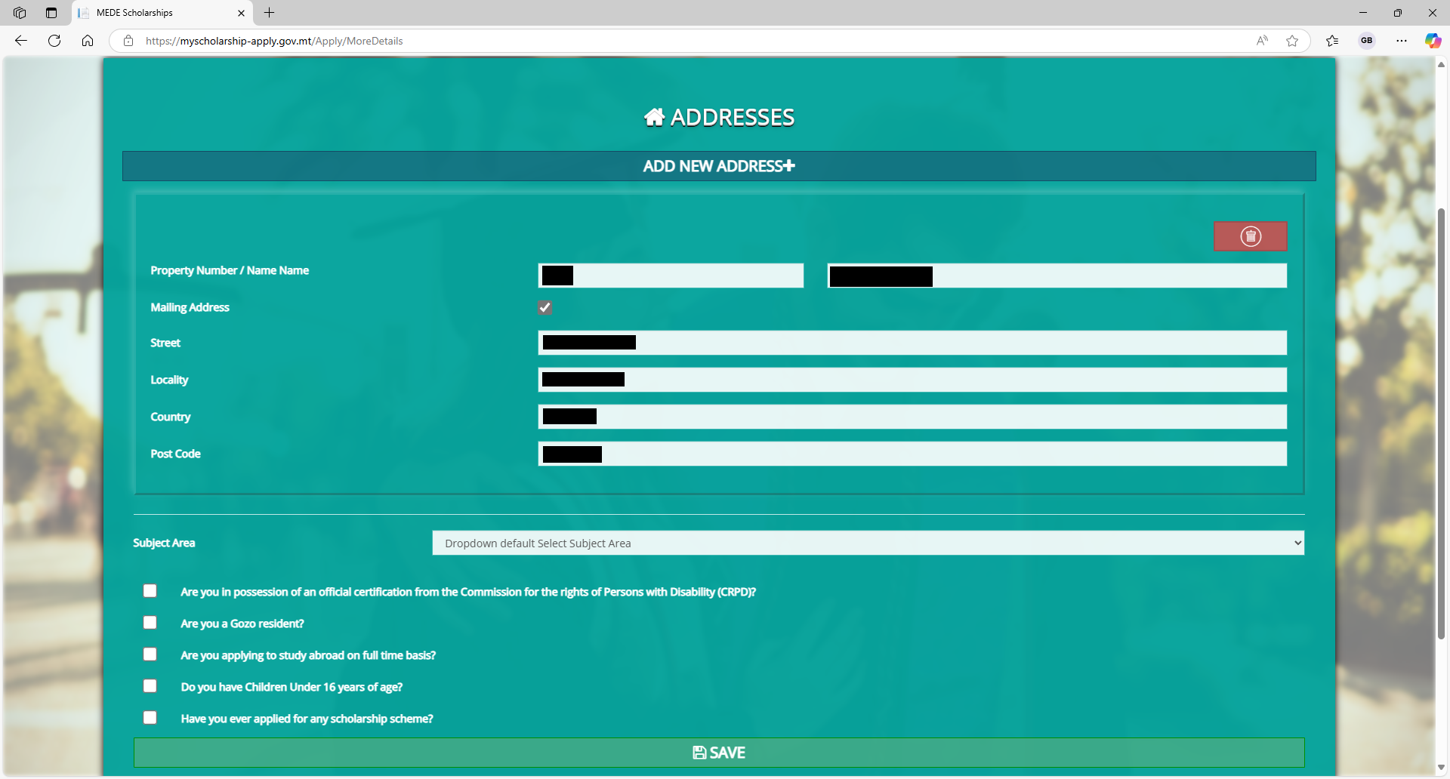

Slide 20
Enter your address
information, if not
already present.

Slide 21
Make sure you select the subject area that pertains to your course

Slide 22
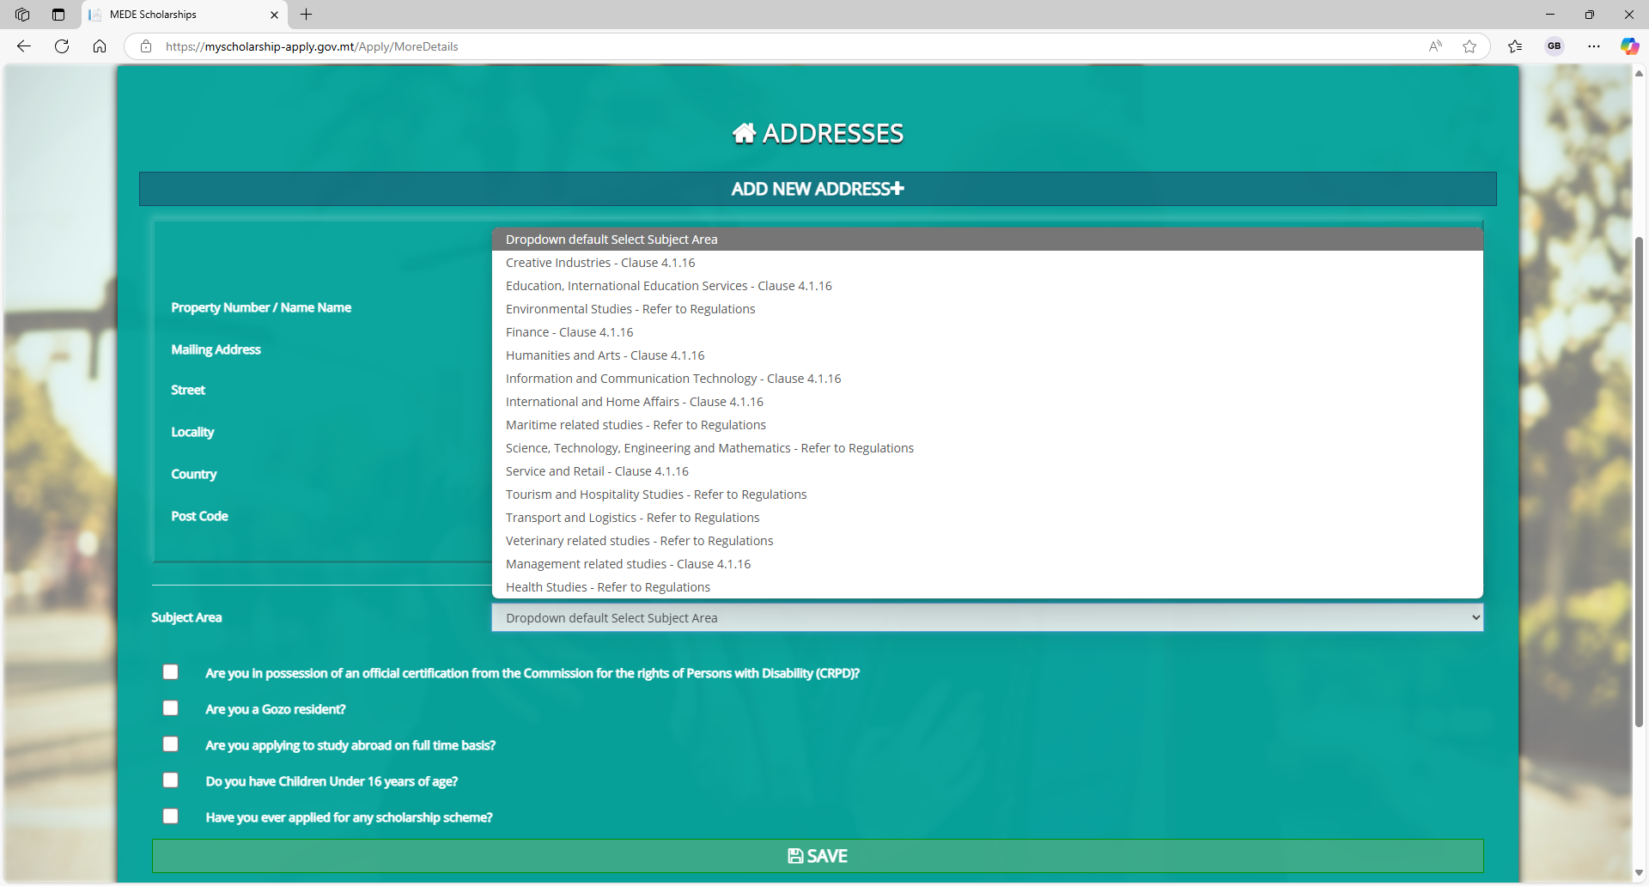
There is a drop-down box of subject areas to choose from.

Slide 23
Correctly tick the boxes
which apply to you.

Slide 24
Once all information on
the page is filled in
correctly, click Save.

Slide 25
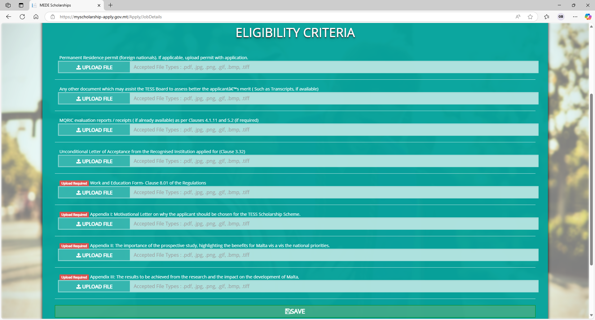

Slide 26
Upload the corresponding
documents in each section.

Slide 27
Documents marked in red are
mandatory. You will not
be able to submit your
application unless you
upload them.

Slide 28
These documents not marked in red are optional for the application process.
However, it is important to send
them to us on artsscholarships.meyr@gov.mt
if you do not submit them with
your application.
Please send these documents
once you have access to them.
The deadline for these is
25th September 2026
by noon (Local Time).

Slide 29
Once you are done
uploading, click Save.

Slide 30
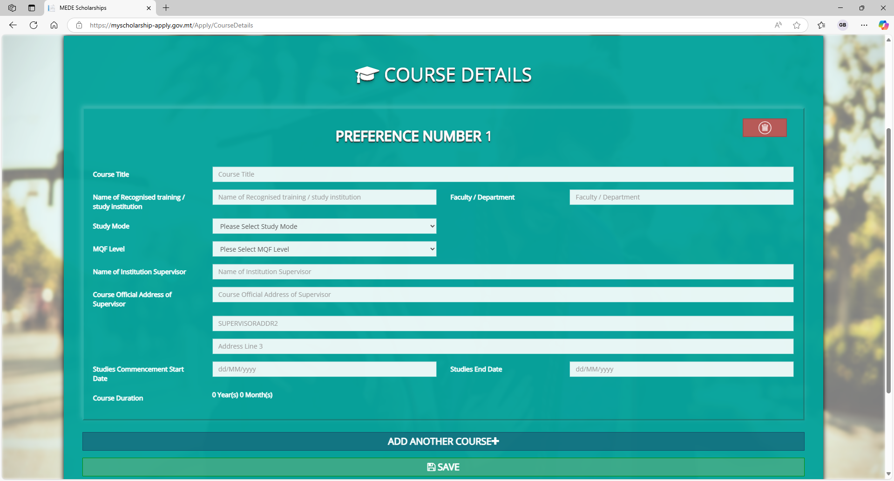

Slide 31
Fill in the details of the
course for which you are seeking a scholarship.
Please ensure all the
information is correct.

Slide 32
You may add up to 5
courses on this page by
clicking Add Another
Course.

Slide 33
Once you are done,
click Save.

Slide 34
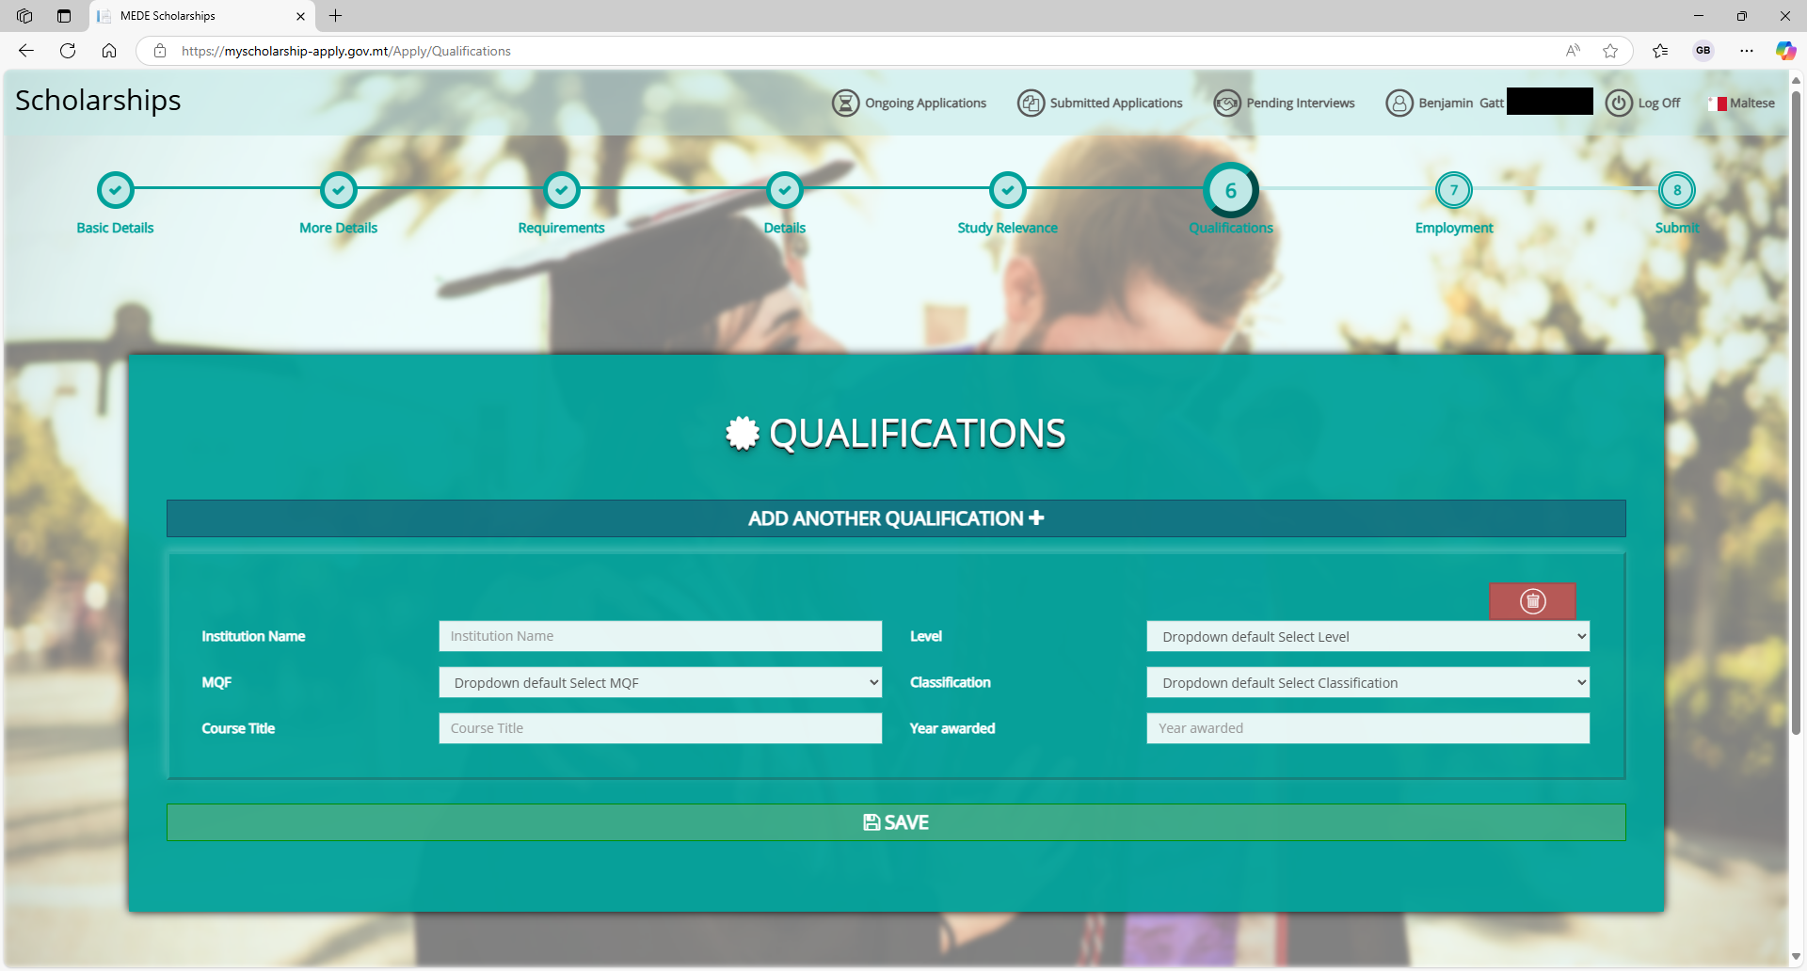

Slide 35
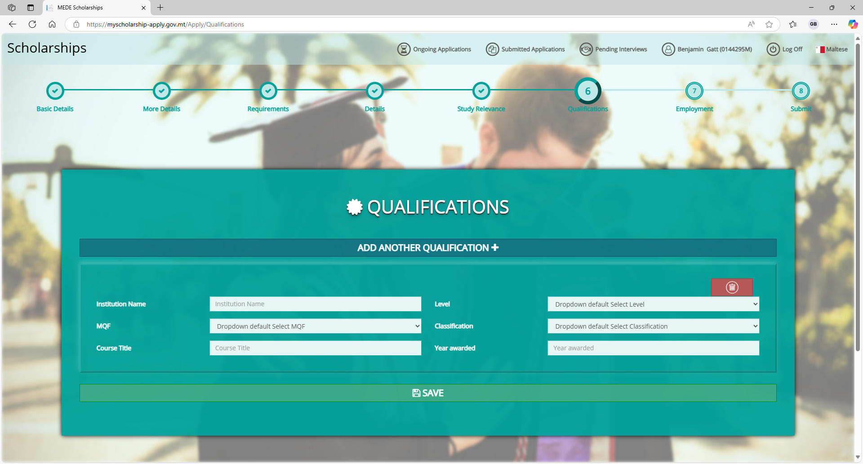
Fill in your qualifications
if not already visible.
When you are ready,
click Save.

Slide 36
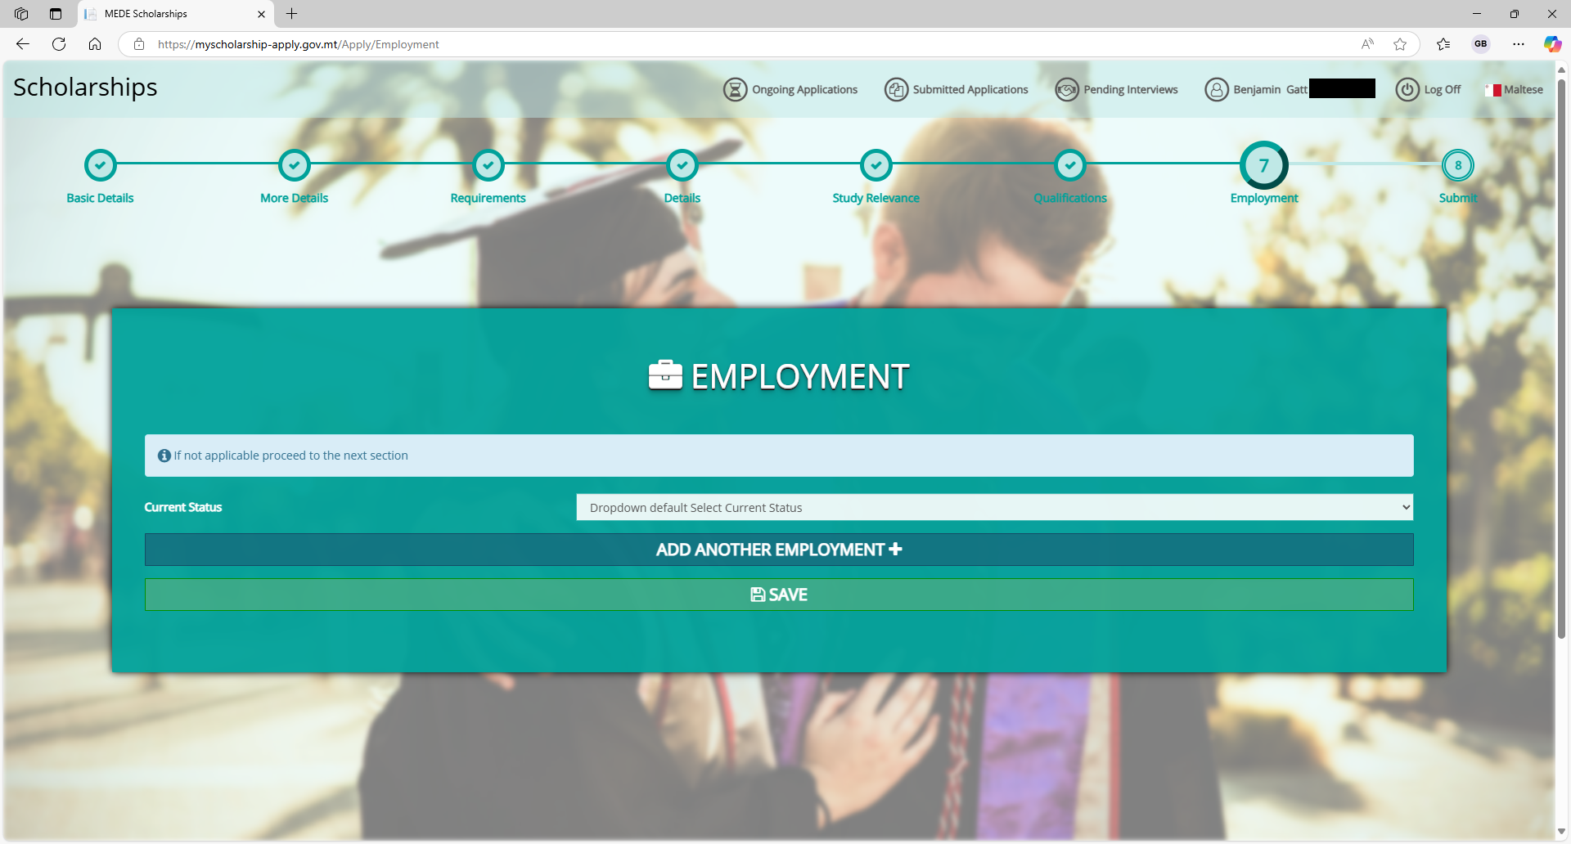

Slide 37
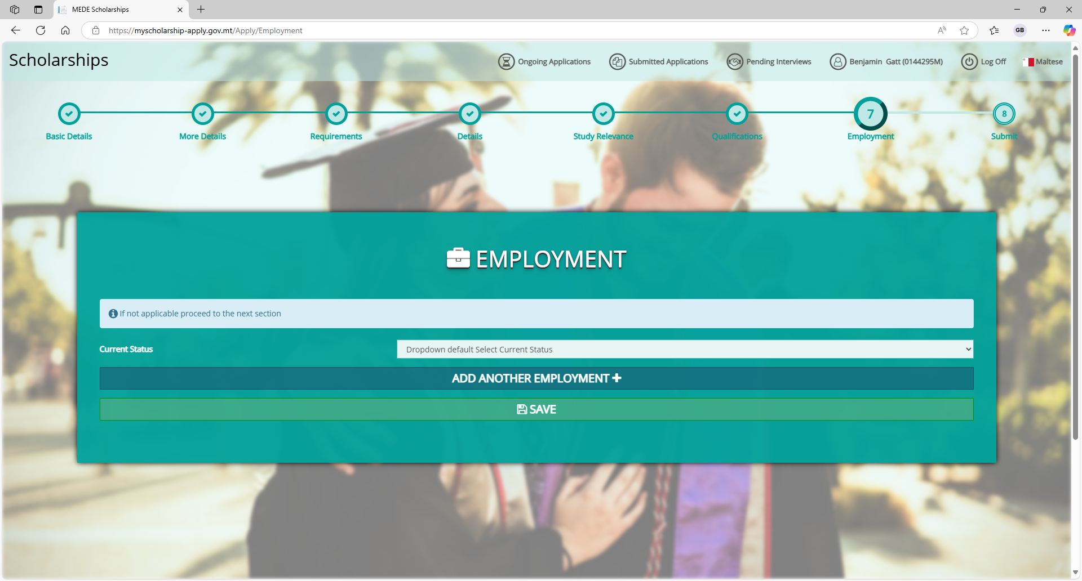
Fill in your employment
history if not already visible.
You may add multiple
jobs by clicking
Add Another Employment.
When you are ready,
click Save.

Slide 38
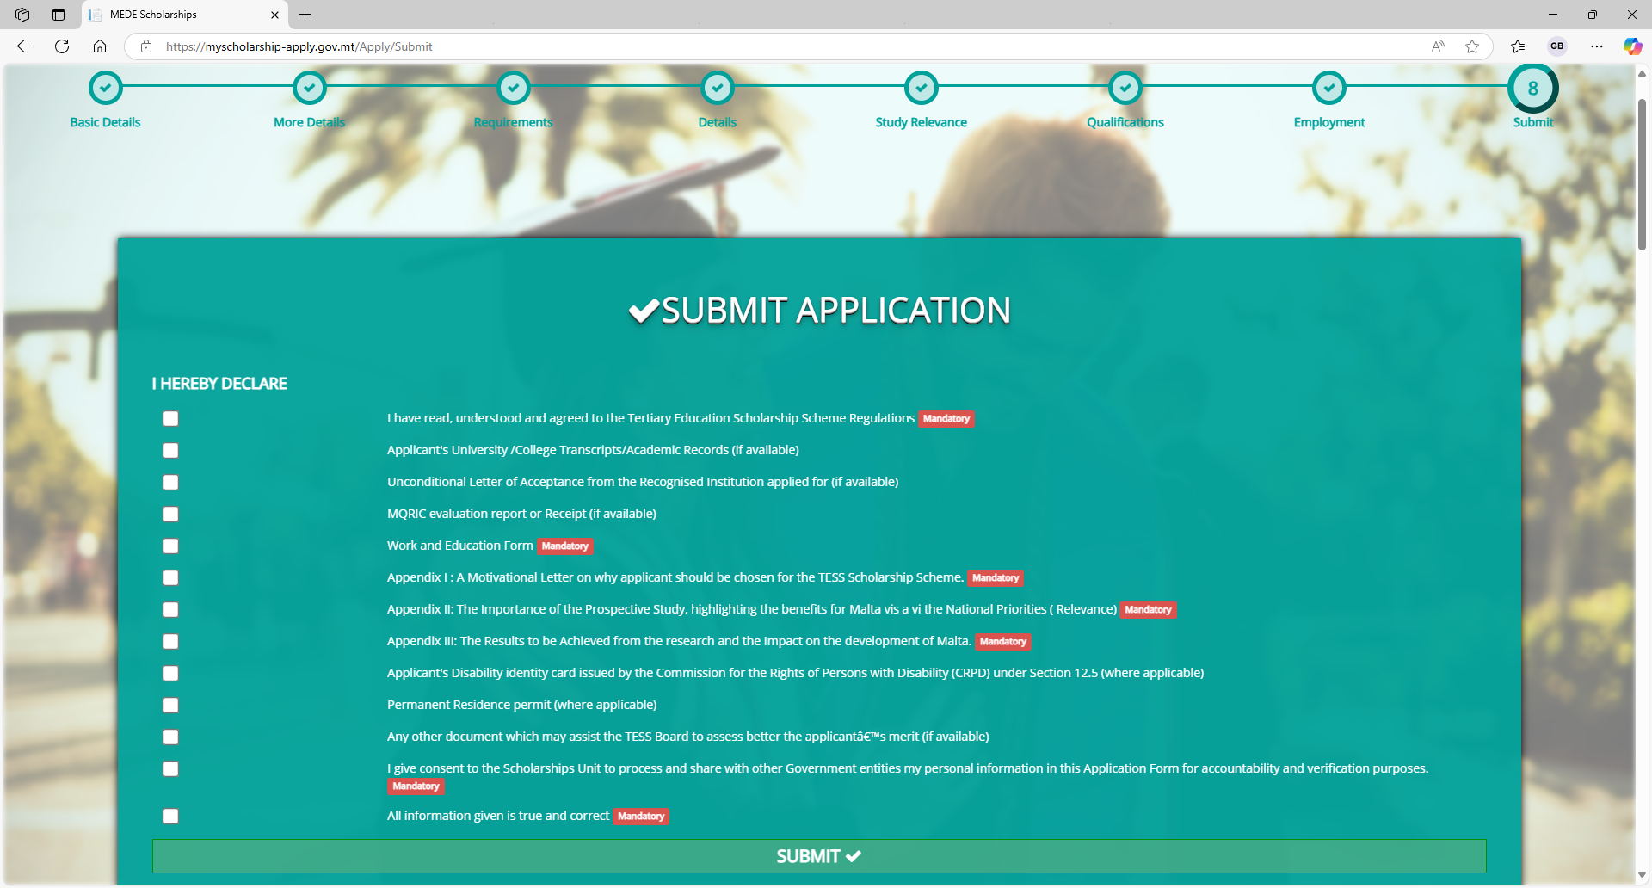

Slide 39
Tick the boxes that
apply to you.
When you are ready,
click Submit.

Slide 40
You have successfully
submitted your application.

