Slide 1


Information Meeting
Malta Arts Scholarship Scheme 2026

Slide 2

Types of Scholarships
(refer to Section 4 in the Malta Arts Scholarship Scheme Regulations 2026)
For Courses Starting Between:
1st of January 2026 and 31st of December 2026
(those who have already begun their programme of studies can still apply, as long as the end date is in 2027 or later)
Courses can be taking place in Malta or abroad
Applicants shall be 13 years of age or over

Slide 3

The Online Application
Opens: 10th of April, 2026
Closes: 13th of May, 2026
What is required?
e-ID
Subject Area
PhD’s proposal for research or overview, and impact of studies to be included with the Personal Profile Report
In case of minors, the parents should apply on their behalf, attaching the necessary declarations.

Slide 4

The Application
By the closing date of the call, one must have the below attached to their application:
CV
Personal Profile Report
Portfolio
MQRIC Report/Receipt
Transcripts and ULA from institution (if available)
Proposal for research, overview and impact of studies needed for Academic programmes.
In case of minors, parents can apply on their behalf with the necessary declarations.
You need an e-ID in order to apply!

Slide 5
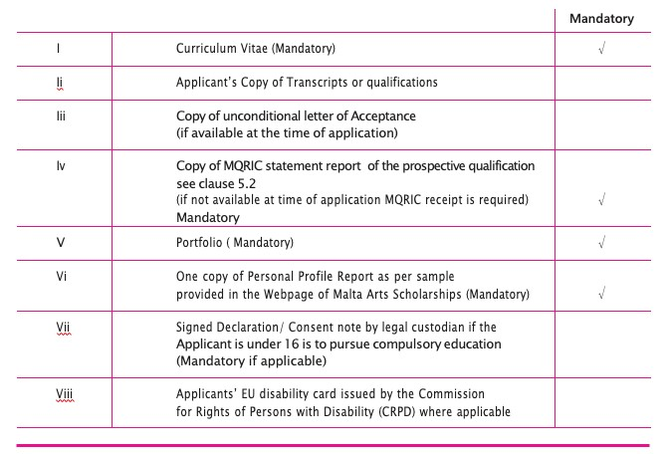
By the closing date of the application, the applicant must have these documents attached in .pdf format. (ULA’s and MQRIC’s are due by the second deadline – Friday 25th September, 2026)
(refer to Clause 7.3 in the Malta Arts Scholarship Scheme Regulations 2026)

Slide 6

Who Can Apply?
Training Programmes
Academic/Vocational Courses all in Expressive and Visual Arts
Courses from MQF Level 5 – 8 of not less than 9 months duration

Slide 7
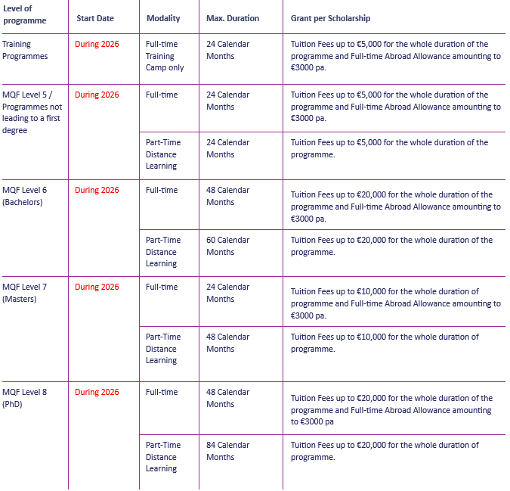
Value and Payments of Scholarship Grant
(refer to Section 11 in the Malta Arts Scholarship Scheme Regulations 2026)

Slide 8

Value and Payments of Scholarship Grant
(refer to Section 11 in the Malta Arts Scholarship Scheme Regulations 2026)
Full-Time Abroad Allowance (FAA)
€3,000 per year for those that study full-time abroad
The scholarship grant will only cover Tuition Fees (TF) in the below cases:
The programme of studies is carried out on part-time or distance learning basis
The programme of studies is carried out on full-time basis in Malta

Slide 9
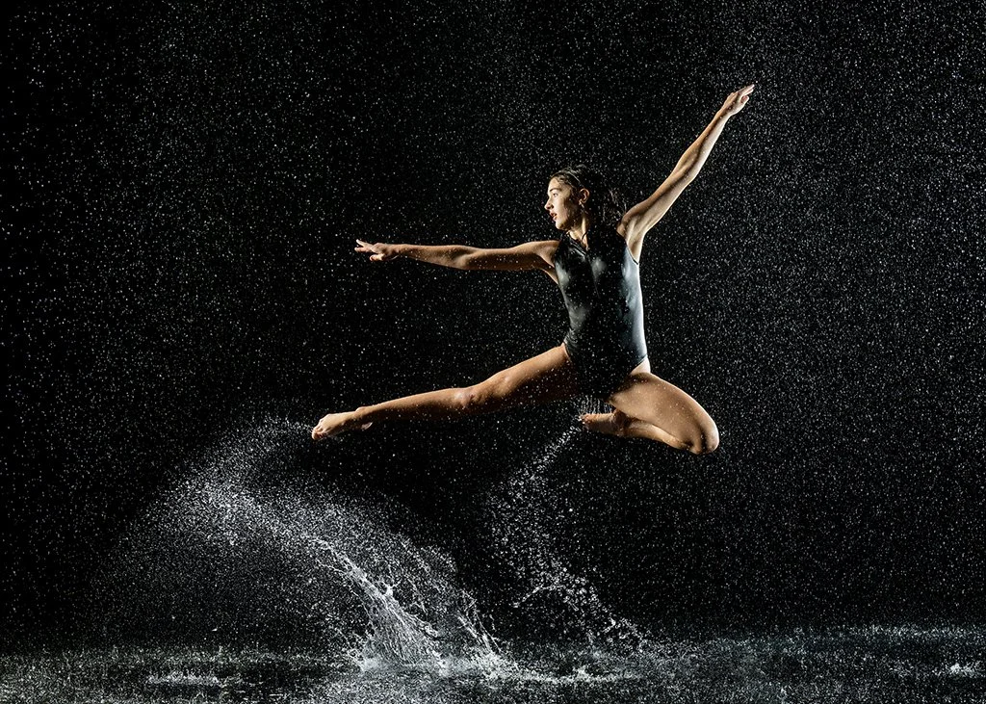
Additional Information
The interview date will be communicated to you at a later stage.
In order to increase the chance of being awarded a scholarship, you may also apply to the Endeavour II or TESS schemes (applicable to MQF 7 or 8).
After the interviews, you will be notified with your interview’s results. If successful, you must submit the ULA and MQRIC by second deadline 25th September.

Slide 10

Second Deadline: 25th September, 2026
ULA
MQRIC Report
Start Date
End Date
Duration
Tuition Fees (and if subject to increase)
Modality
ECTS/Number of Hours per week
(for boarders: if applying for a training programme, the ULA has to show details regarding the training programme only.)
The MQRIC Report corresponding to your prospective qualification must state that both the status of institution and programme are both Recognised.
Foreign Institutions only for courses already obtained. Excluding UoM, MCAST and ITS.

Slide 11

Recap of Important Dates
Application Opens: 10th of April, 2026
Application Closes: 13th of May, 2026
Second Deadline (ULA and MQRIC): 25th of September, 2026

Slide 12

Contact Number: 2598 2676
Email Address: artsscholarships.meyr@gov.mt
Website: https://myscholarship.gov.mt

Slide 13

Thank you for your attention!
Any questions?

