Slide 1
Online Application Form
Achieve 360

Slide 2
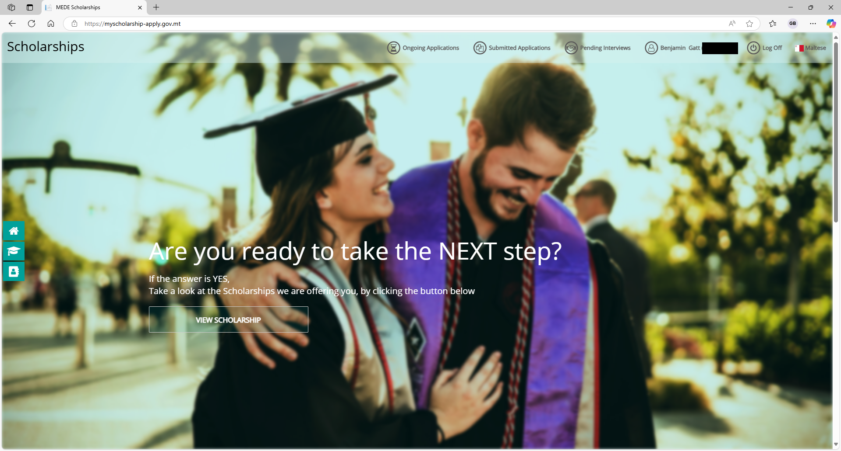

Slide 3
To apply online, visit
https://myscholarship-apply.gov.mt
then click
View Scholarship

Slide 4
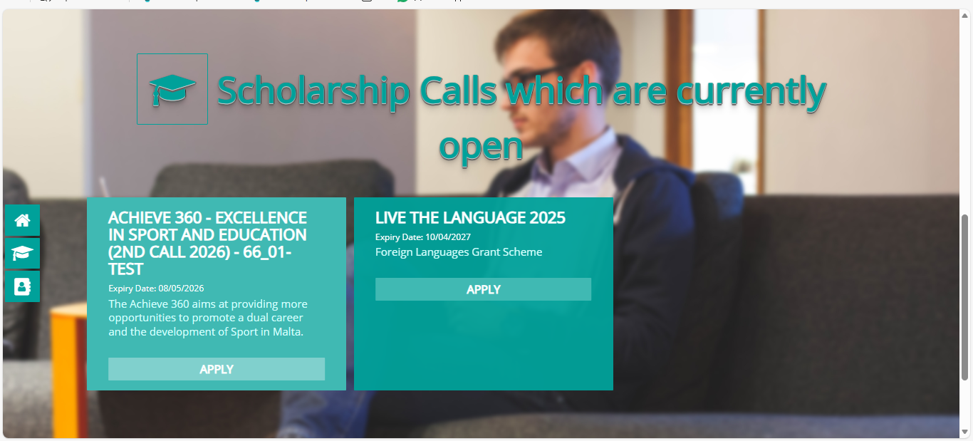

Slide 5

Click on Achieve 360
Click Apply under the
TESS scholarship

Slide 6
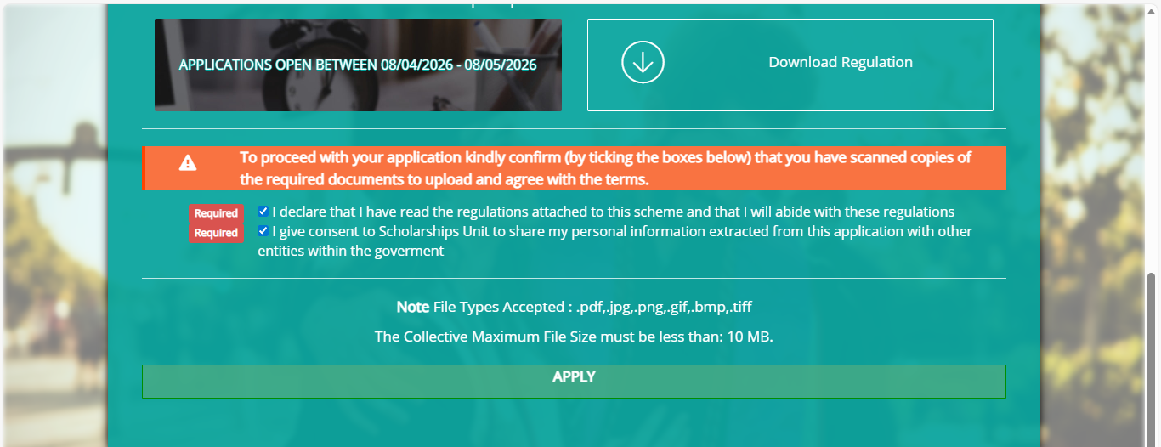

Slide 7
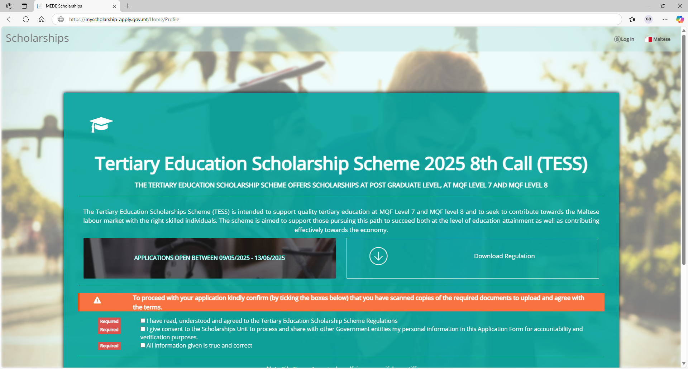
Click Log In at the
top right of the window

Slide 8
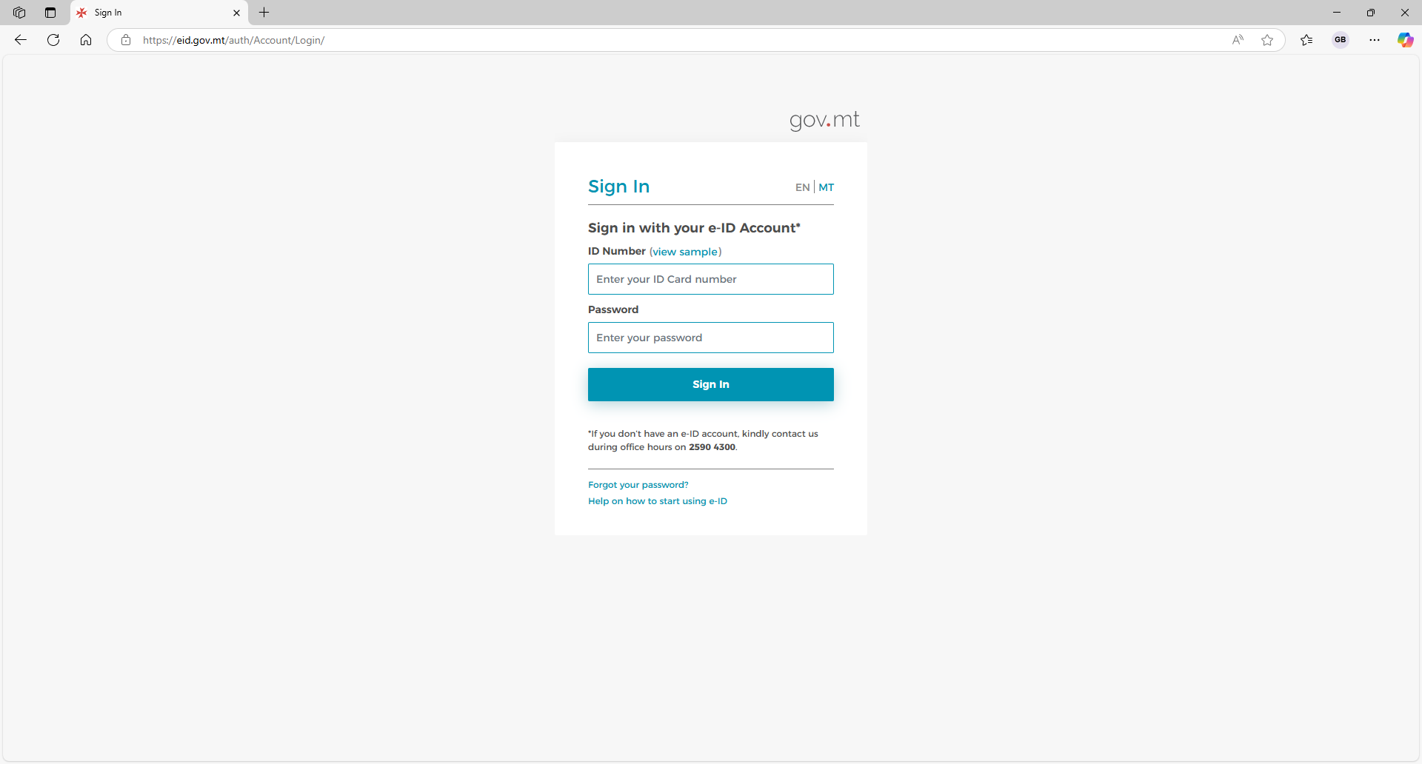

Slide 9
Sign in using
your e-ID

Slide 10
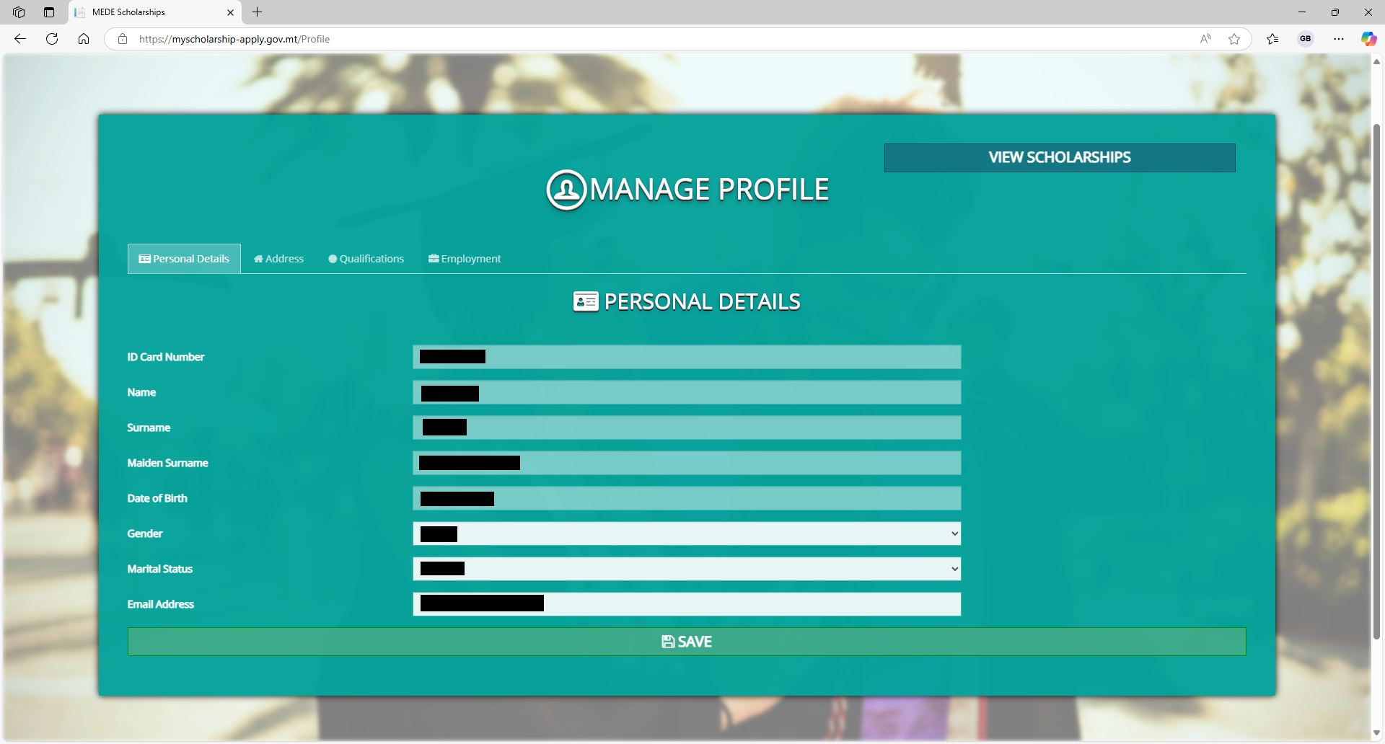

Slide 11
Ensure all the details
in your profile are
correct.

Slide 12
Do not forget to
check each tab.

Slide 13
Once you are done,
click Save.

Slide 14
Then click
View Scholarships.

Slide 15
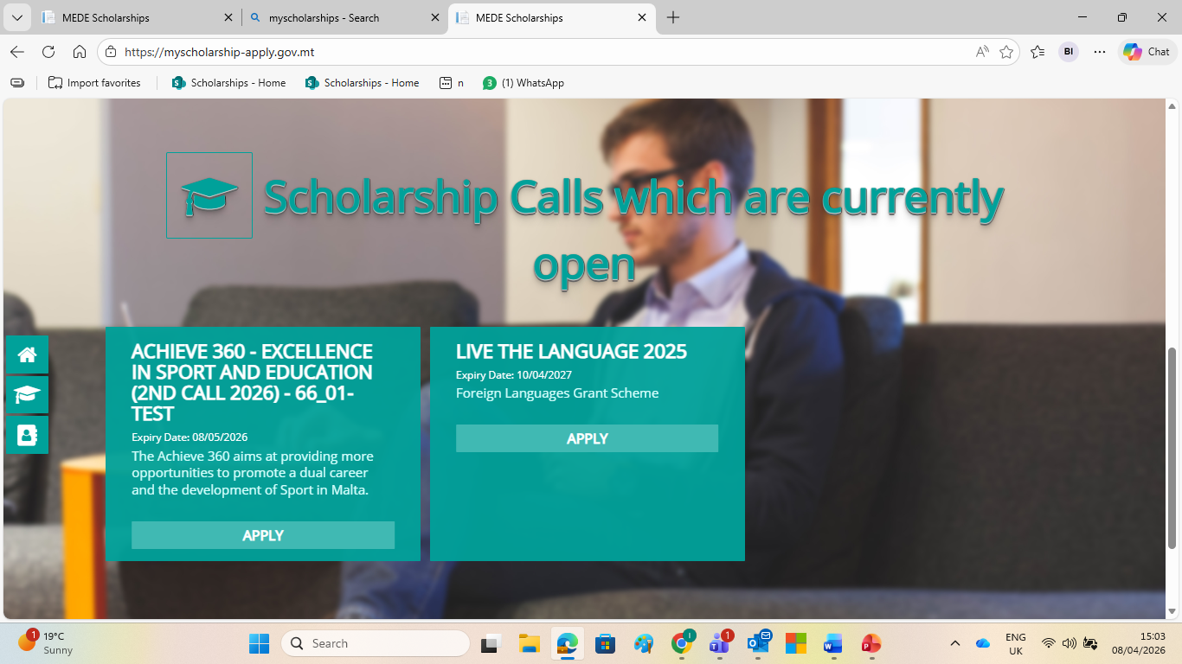

Slide 16
You will be redirected to this page. Once again, click apply on Achieve 360

Slide 17
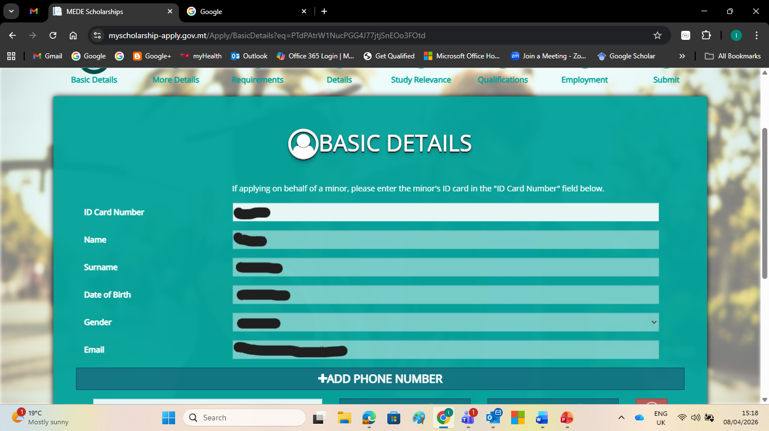

Slide 18
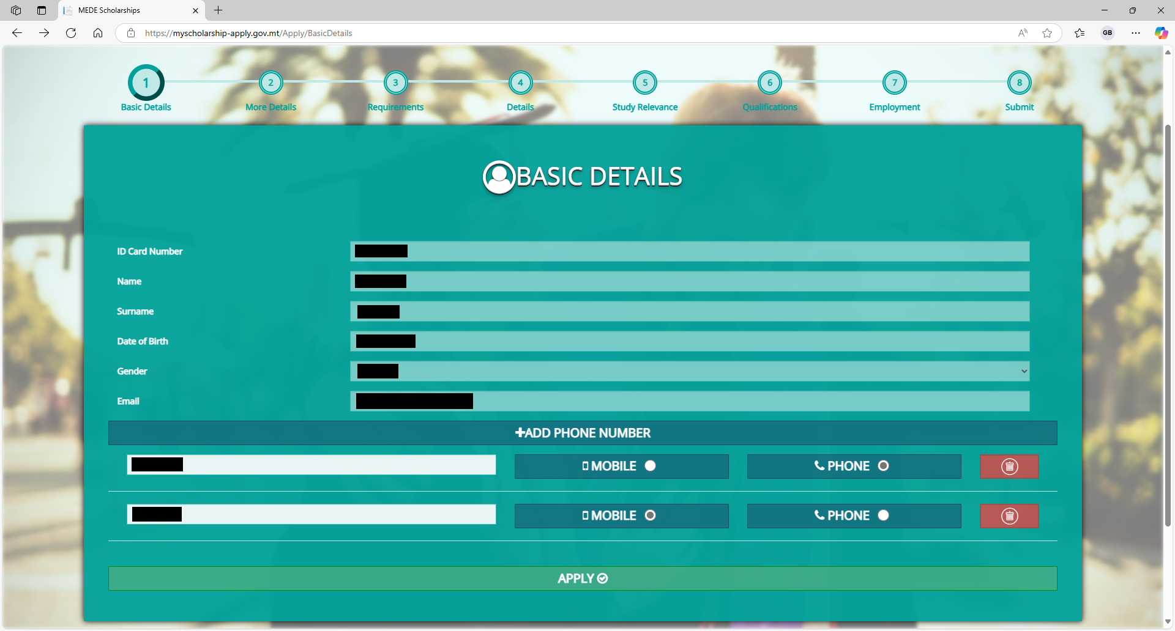
These details should now
be filled in automatically
Ensure all information
is correct, and then
click Apply.

Slide 19
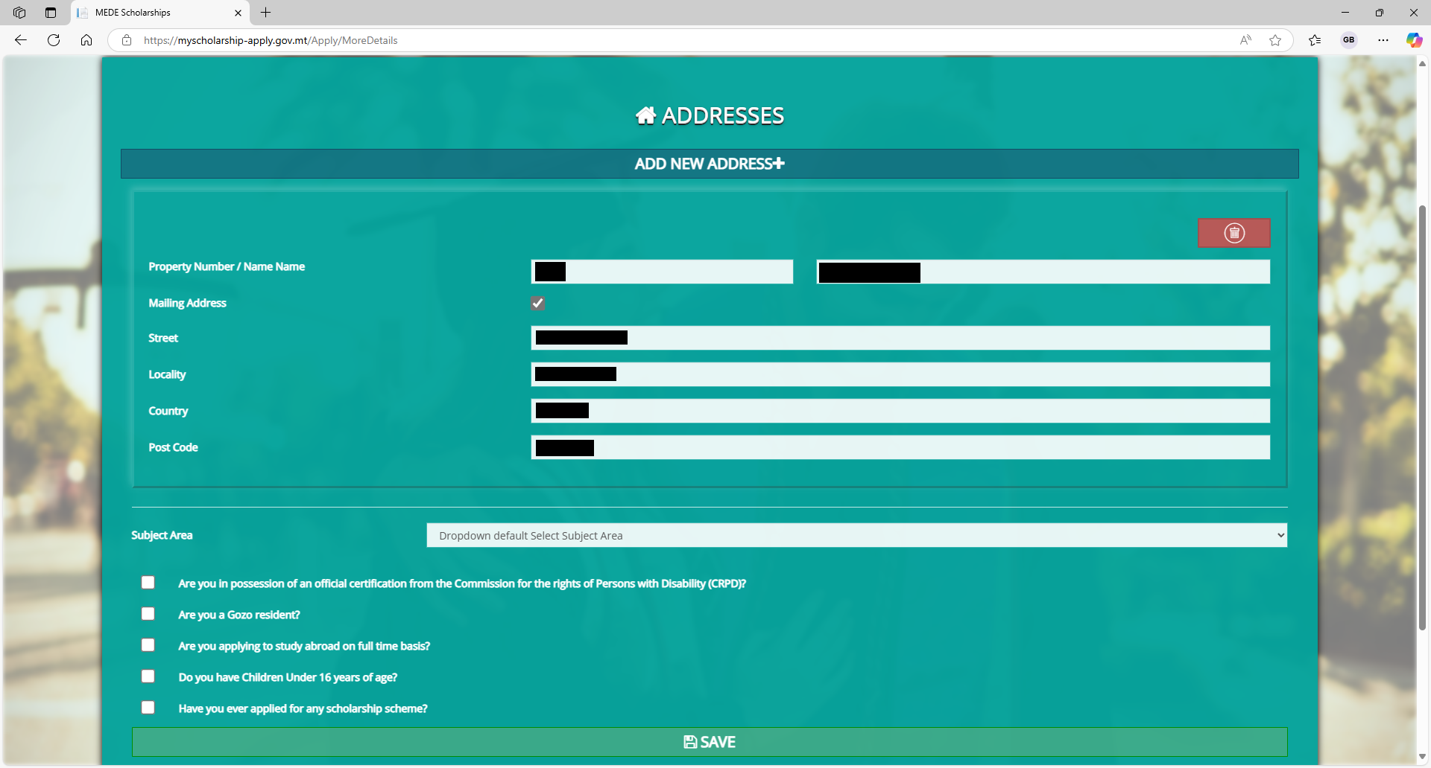

Slide 20
Enter your address
information, if not
already present.

Slide 21
Make sure you select the subject area that pertains to your course

Slide 22
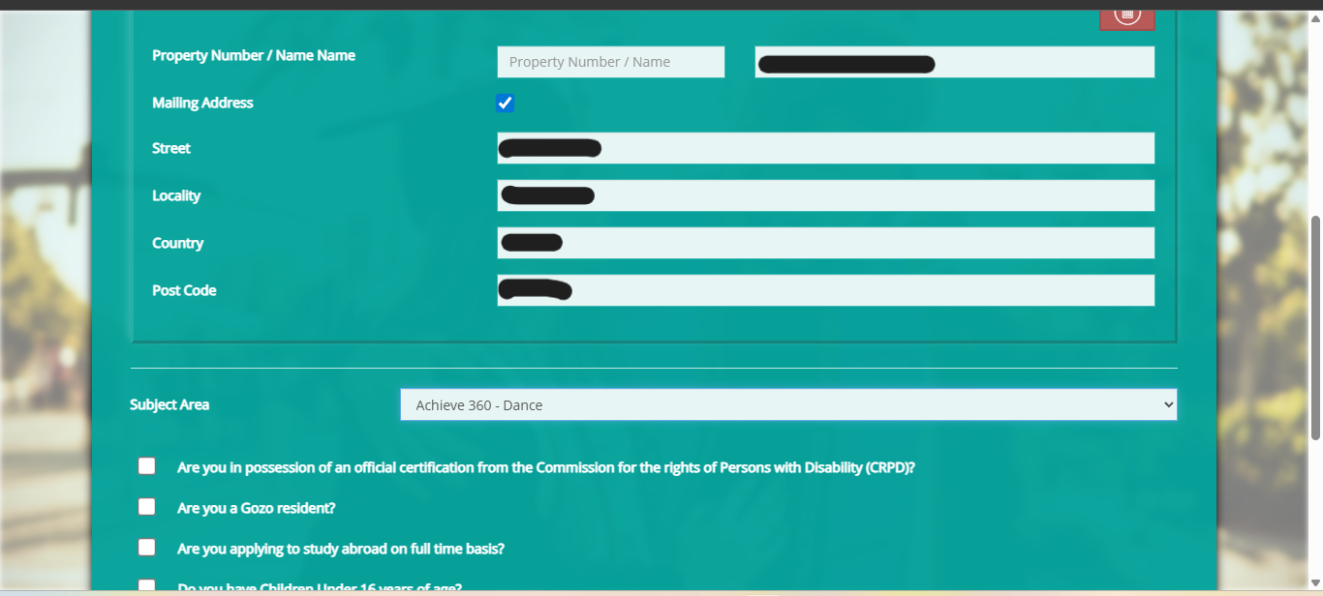
There are 15 subject
areas to choose from

Slide 23
Correctly tick the boxes
which apply to you.

Slide 24
Once all information on
the page is filled in
correctly, click Save.

Slide 25
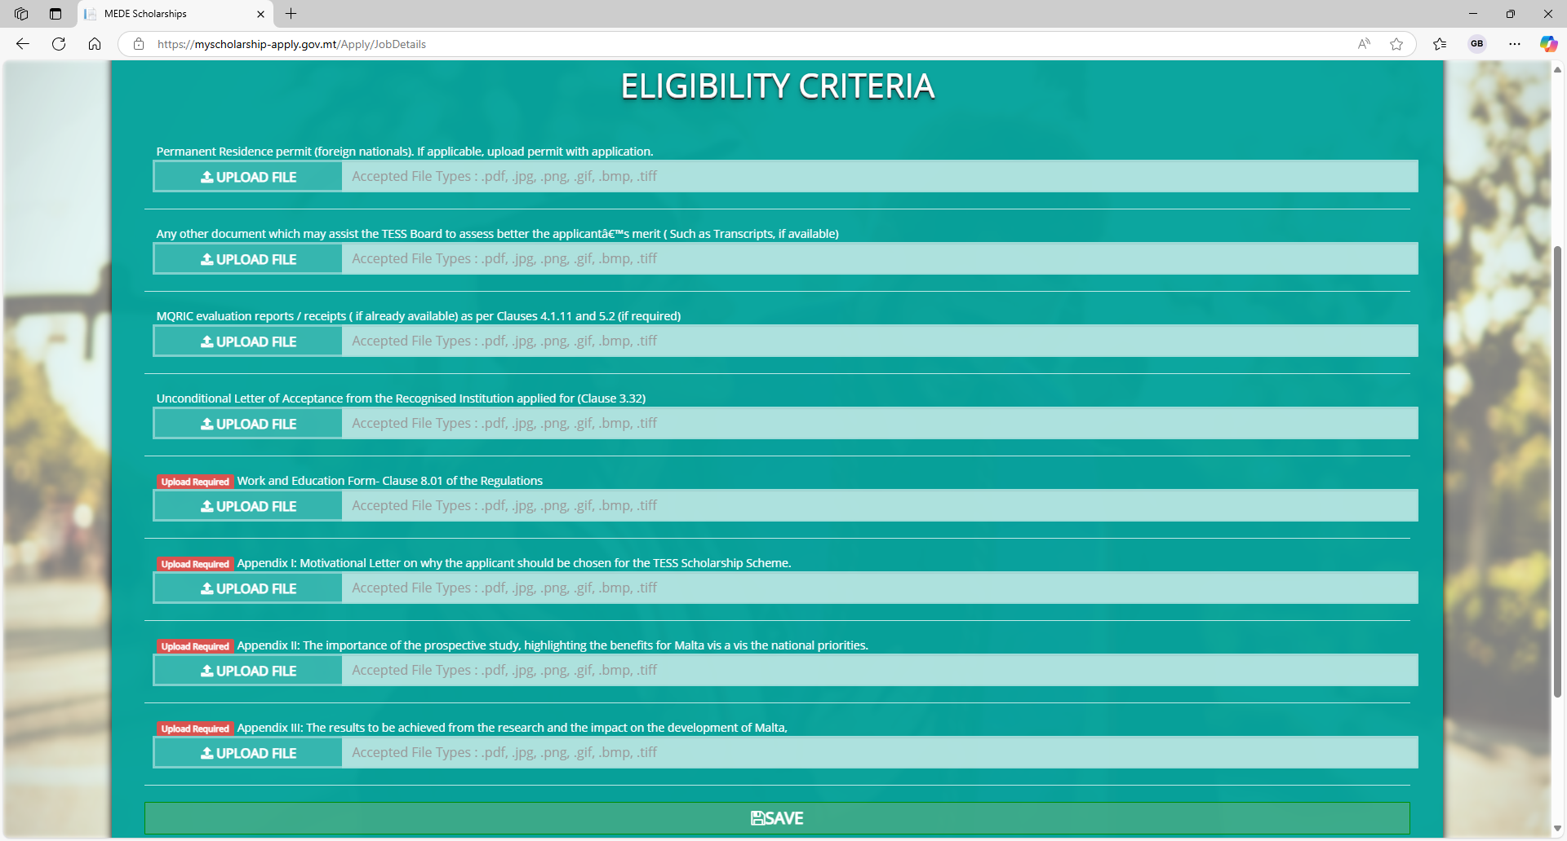
Please refer to the Achieve 360 Regulations – 4 Eligibility pages 6-9

Slide 26
Upload the corresponding
documents in each section.

Slide 27
These documents are
mandatory. You will not
be able to submit your
application unless you
upload them. See Regulations Applications Forms pages 9-11

Slide 28
Once you are done
uploading, click Save.

Slide 29
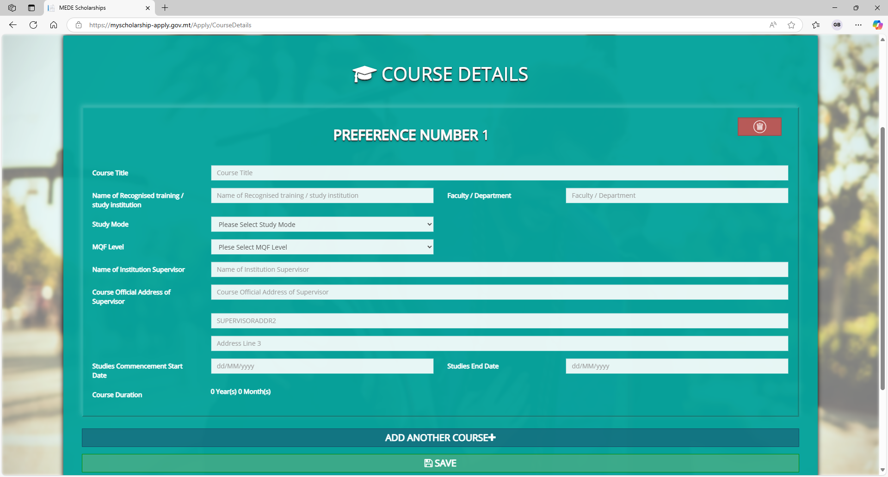

Slide 30
Fill in the details of the
course for which you are seeking a scholarship.
Please ensure all the
information is correct.

Slide 31
Once you are done,
click Save.

Slide 32
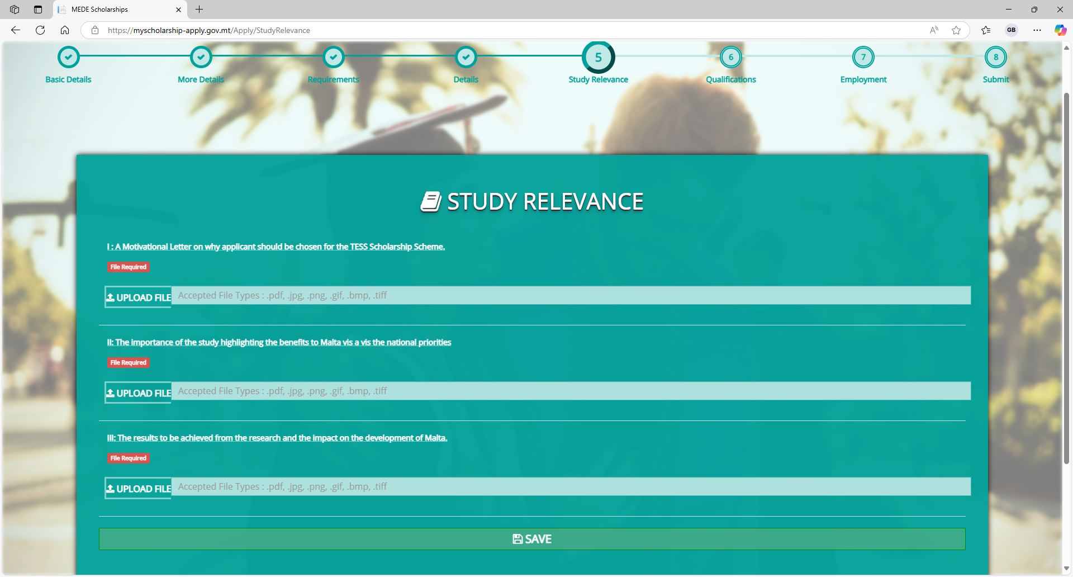
Here you must once again upload the three appendices mentioned earlier.
When you are ready,
click Save.

Slide 33
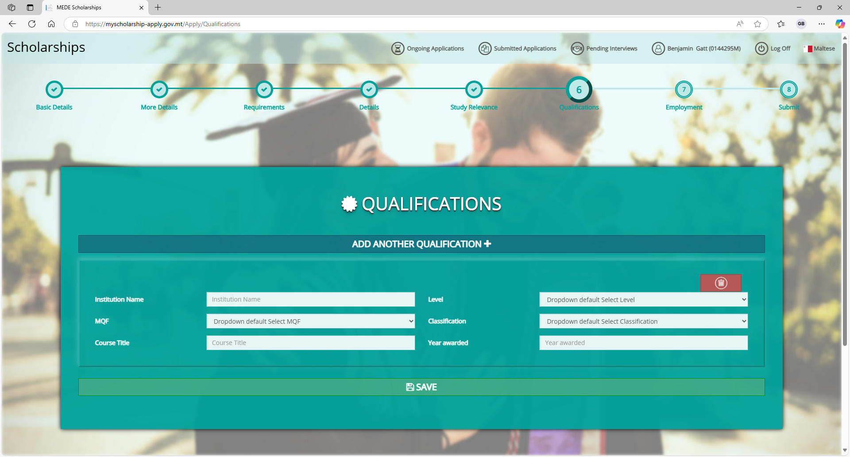
Fill in your qualifications
if not already visible.
When you are ready,
click Save.

Slide 34
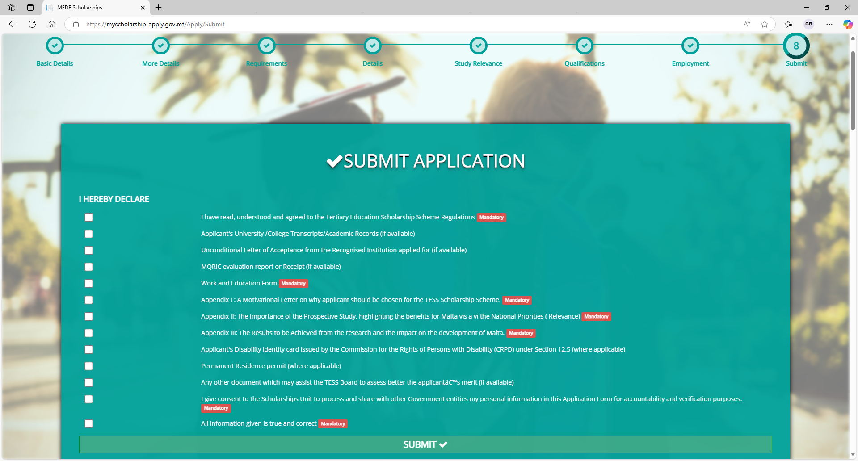

Slide 35
Tick the boxes that
apply to you.
When you are ready,
click Submit.

Slide 36
You have successfully
submitted your application.

