Slide 1
LIVE THE LANGUAGE
Information Session 2025
PRESENTED BY
Daniela Pace
myscholarship.gov.mt

Slide 2
Scheme Overview
Live the Language
Ages
Languages
Grant
11 - 21
ALL
Up to €850

Slide 3
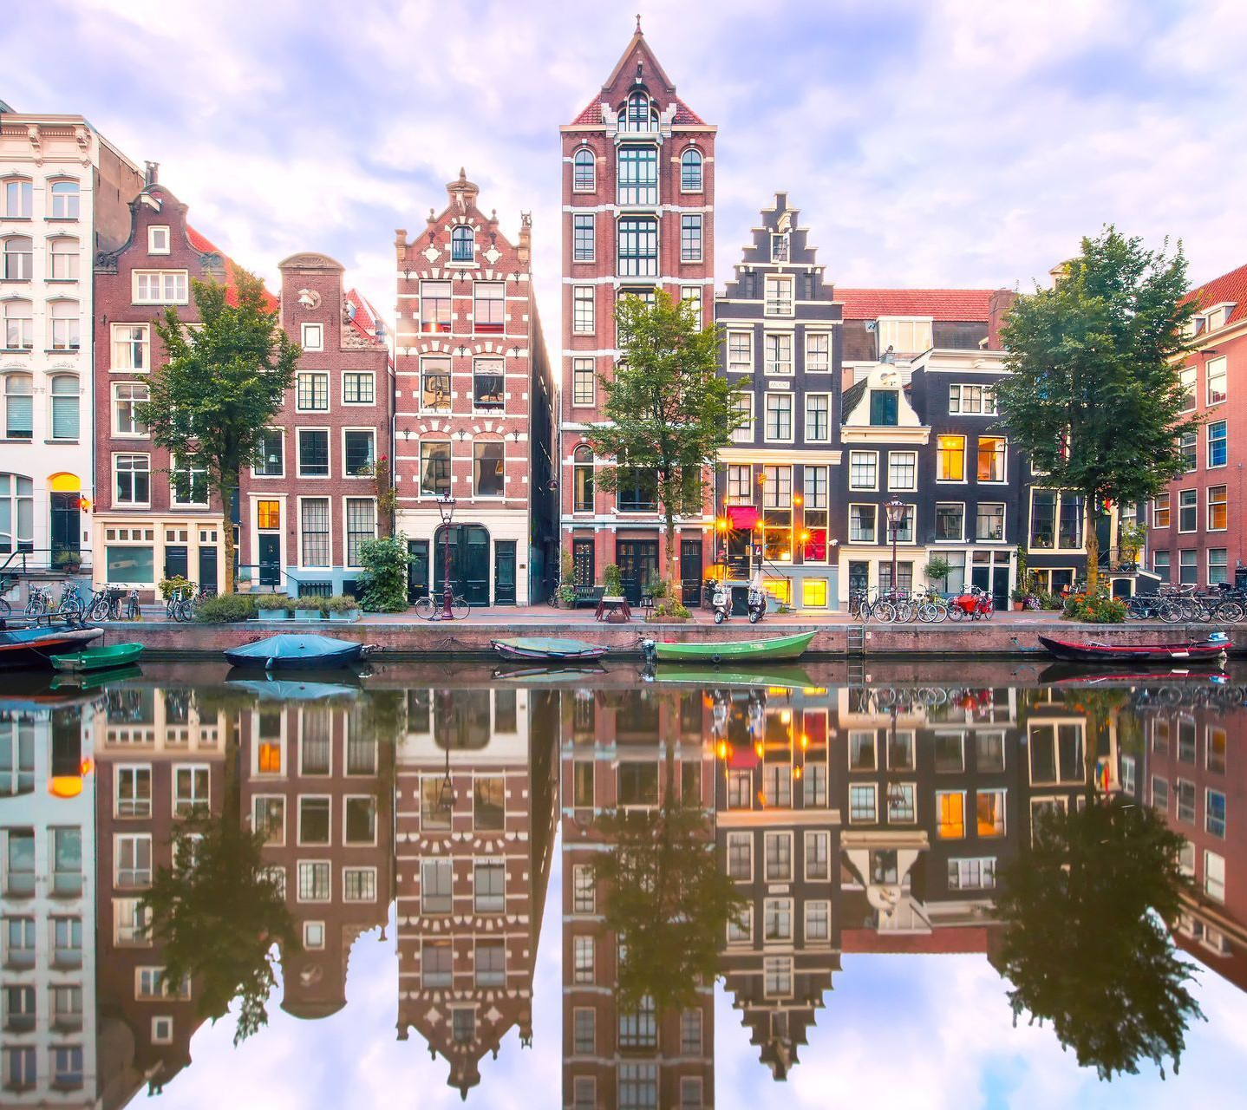
01
Grant is paid pro-rata on the presentation of relevant documents.
02
State Schools: 49%
Church Schools: 11%
Independent Schools: 40%
03
Scheme will remain open until funds are exhausted.

Slide 4
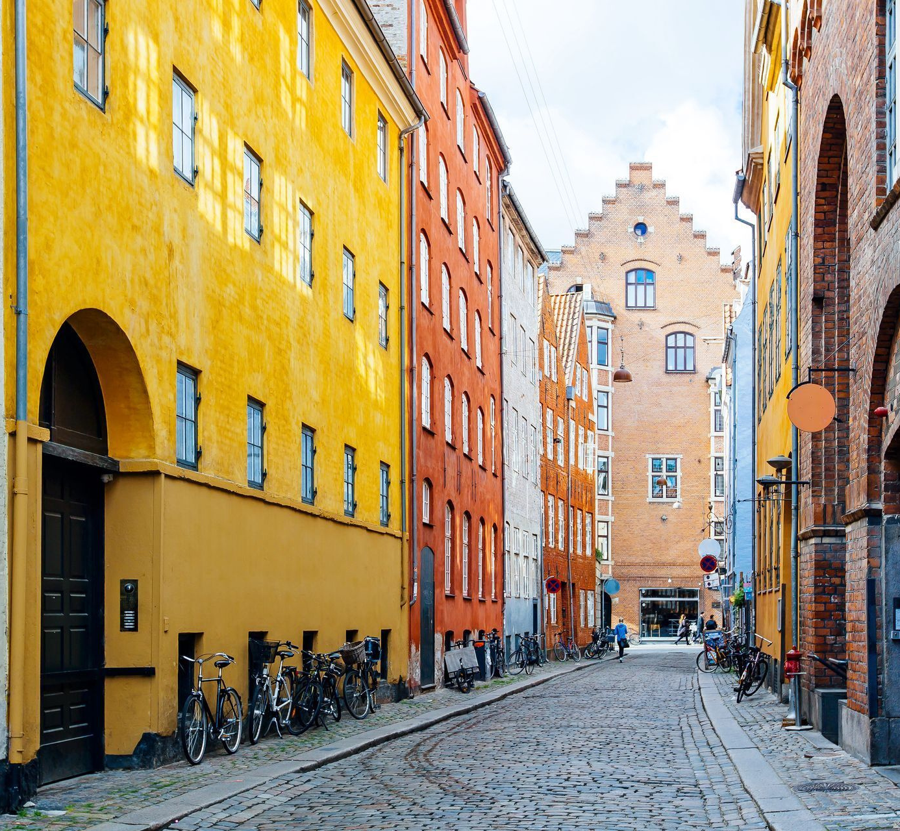
Only online applications are accepted.
04
Make sure to have an active e-ID account and your IBAN number ready.
05
Applications are to be submitted no later than 3 months after course completion.
06
myscholarship-apply.gov.mt

Slide 5
Steps
Apply for the scheme after completing your language course
Course
Apply
Review
Funds
Complete a course in a language of your choosing
No later than 3 months after course completion
The board will review your submitted application
If awarded, you will receive the funds based on documentation submitted

Slide 6
Documentation
Eligible Costs
Course Fees
Charged directly by the recognised institution
Invoices
Accommodation
Receipts
Addressed to applicant or parent/legal guardian.
Include check in and check out dates.
Max. of two additional nights allowed (one day before and one day after the course).
Bank Statements
Flights
Flight Tickets
Dates in line with course programme.
Any other travel expenses are not covered.
or
Boarding Passes

Slide 7
Documentation
Certification
Certificate of Attendance / Award
Must include the following information:
Name of applicant
Start and end dates
Date when issued
Total number of hours attended
Name of course
Level of language proficiency

Slide 8
Documentation
Forms
These forms can be found on the scholarship website:
Financial Identification Form (TR/S-9)
myscholarship.gov.mt
Data Protection Form
Fill in forms in blue ink and submit with the rest of the documents
Consent Form (for parent / legal guardian)

Slide 9
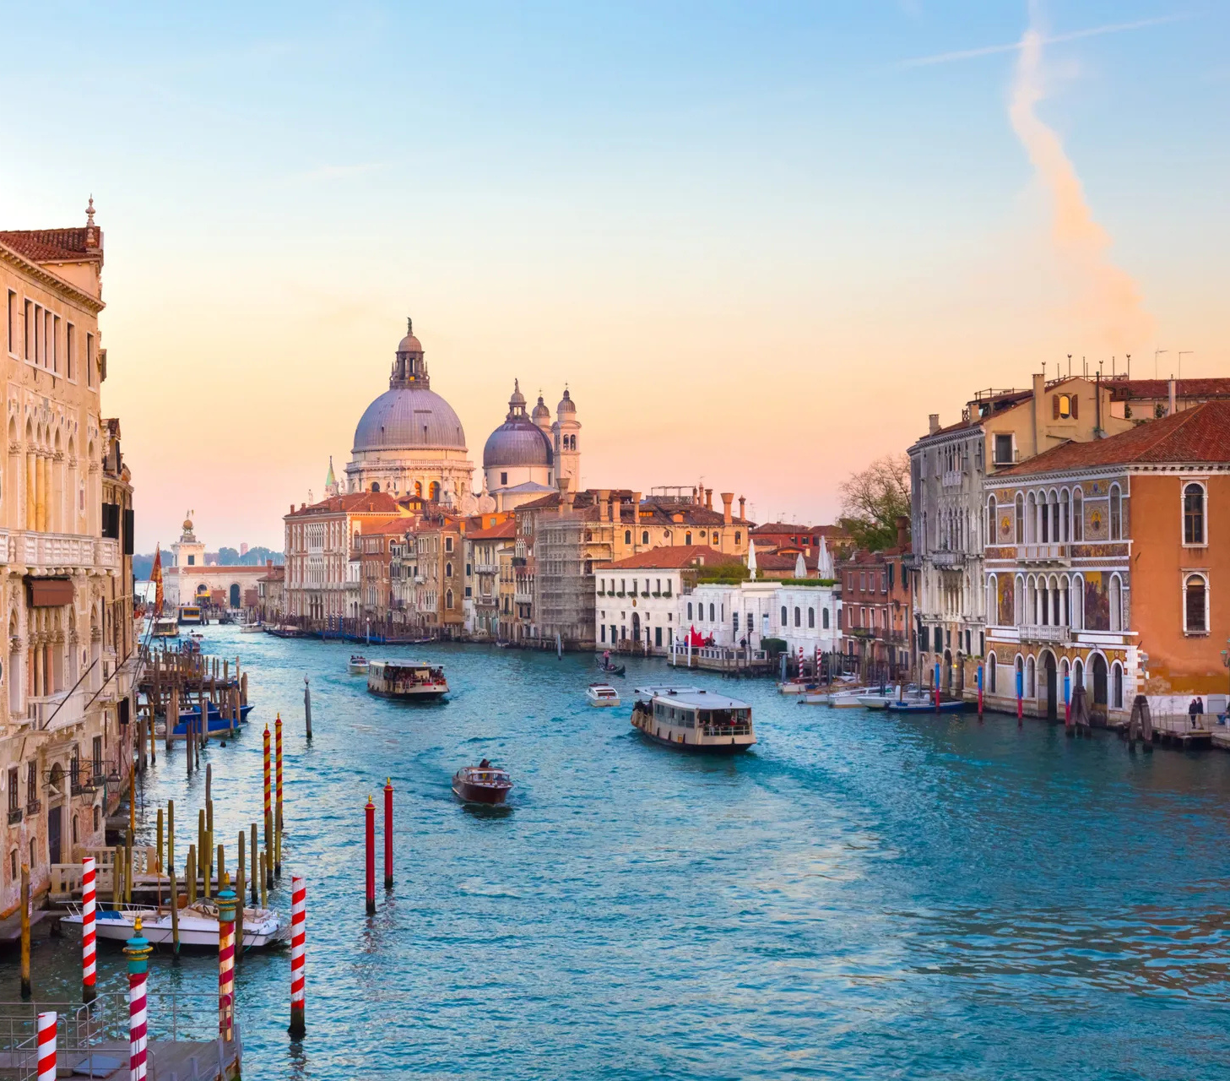
01
Course must be at least 15 hours in duration.
02
Start date must be after the launch of this scheme - 6th May 2025.
03
Online language courses are not covered under this scheme.

Slide 10
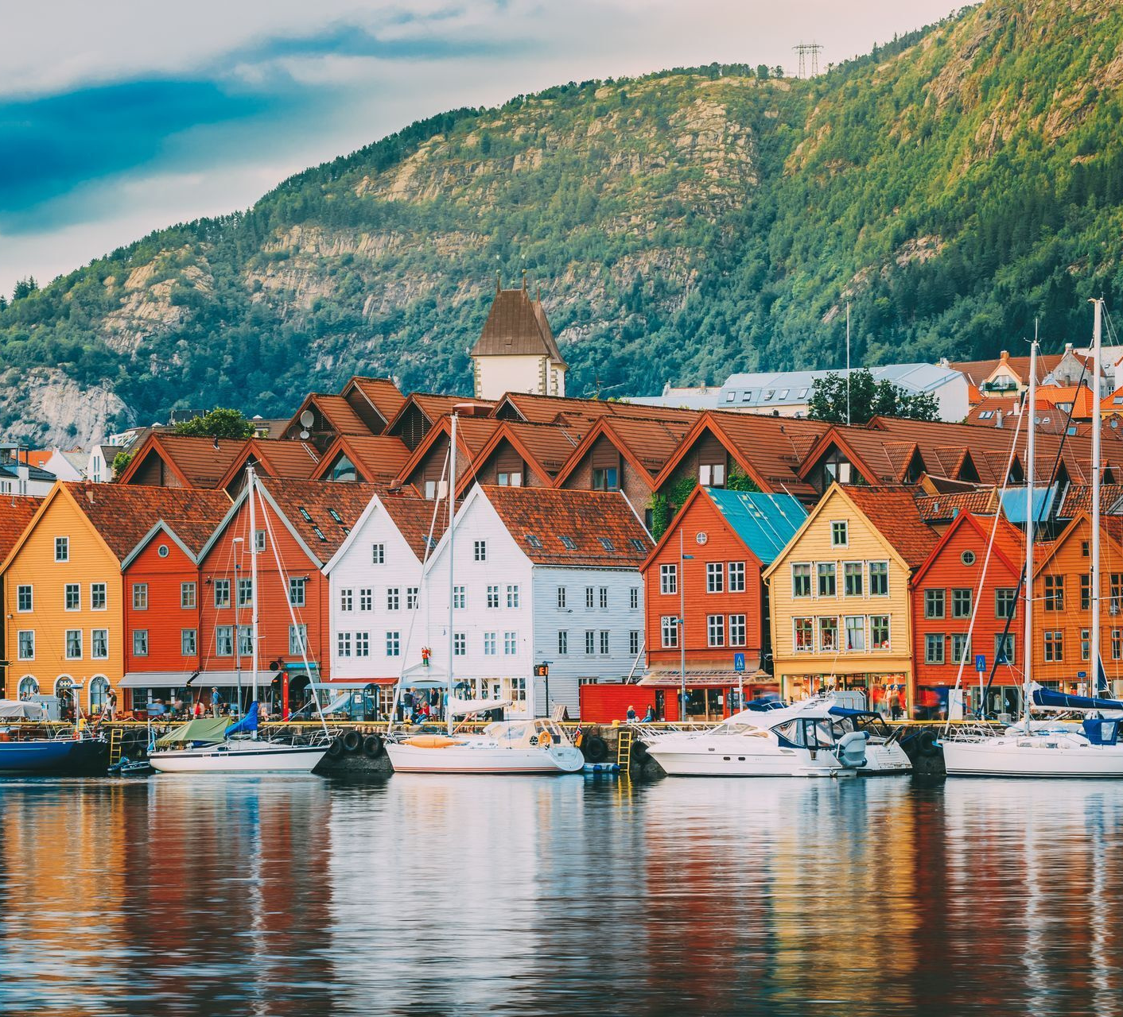
You may apply for any level of a training programme.
04
You may re-apply for another course 3 months after the previous course is completed.
05
Minors under the age of 18 can only participate with the consent of their parents/legal guardians.
06

Slide 11
07
MEYR has appointed the LTL Board to operate the process of eligibility.
08
This Board shall be responsible for all matters concerning the application process.
09
Applicants shall become ineligible for a Grant if they are in breach of any part of the regulations.

Slide 12
Thank you
CONTACT US
E-mail
livethelanguage.meyr@gov.mt
Phone
2598 2667
Address
Ministry for Education, Sport, Youth, Research and Innovation
Scholarships Unit,
Great Siege Road
Floriana VLT 2000
Malta
myscholarship.gov.mt

